Slide 1
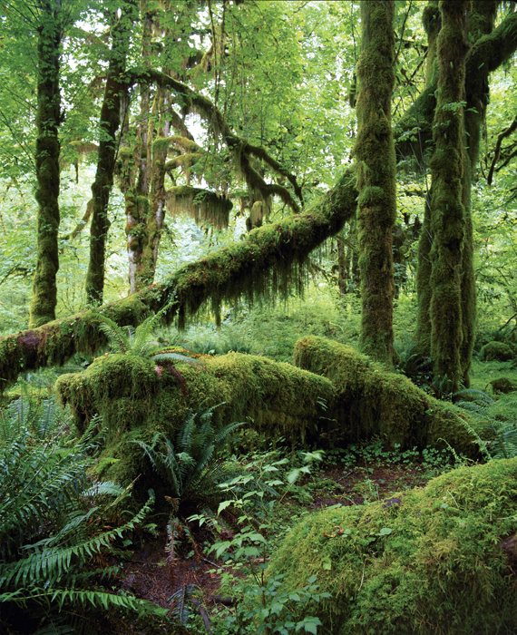
KEY CONCEPT Marine ecosystems are global.

Slide 2
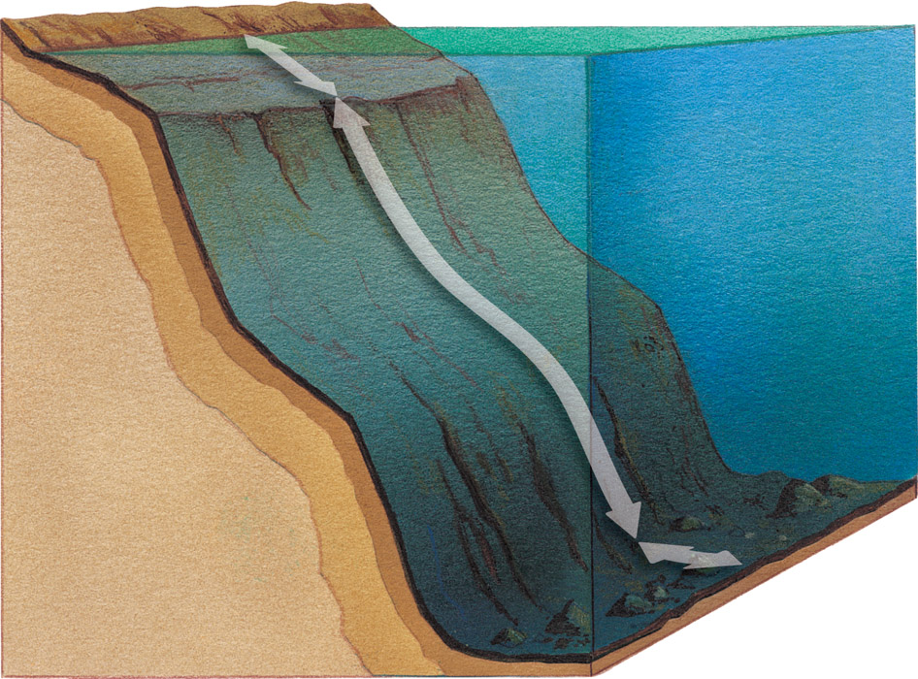
The ocean can be divided into zones.
Ocean zones can be determined by their distance from shoreline and water depths.
intertidal zone—between low and high tide
neritic zone—from intertidal zone to continental shelf
bathyal zone—from neritic zone to base of continental shelf
abyssal zone –lies below 2000 m
intertidal zone
neritic zone
bathmat zone
abyssal zone

Slide 3
The neritic zone harbors more biomass than any other zone.
Plankton make up most of the biomass.
zooplankton
phytoplankton

Slide 4
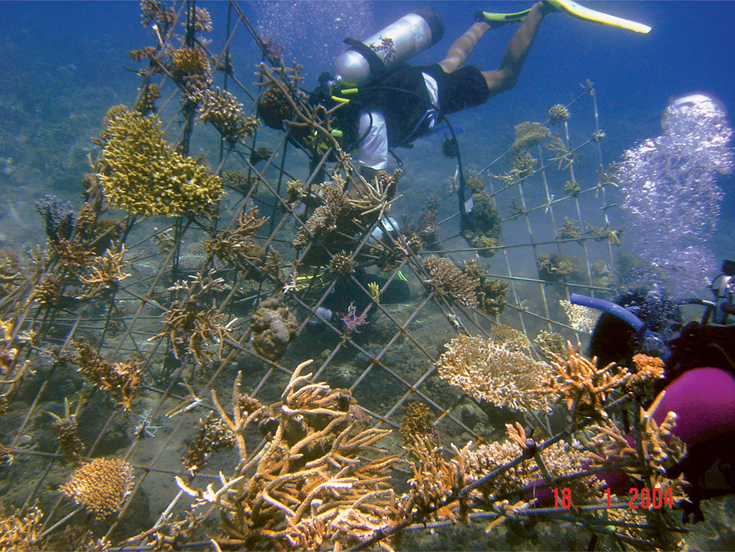
Coastal waters contain unique habitats.
Coral reefs are found in warm waters.
tropical climate zone
great amount of biomass

Slide 5
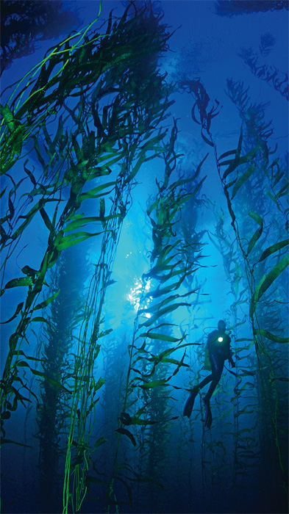
Kelp forests are found in cold, nutrient-rich waters.
large communities of seaweed
great amount of biomass

