Slide 1
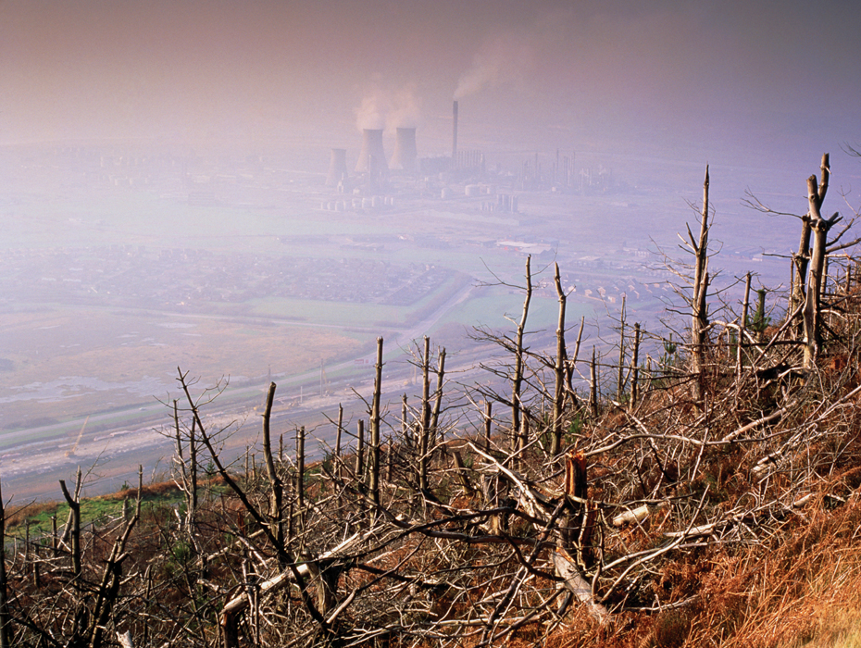
KEY CONCEPT The impact of a growing human population threatens biodiversity.

Slide 2
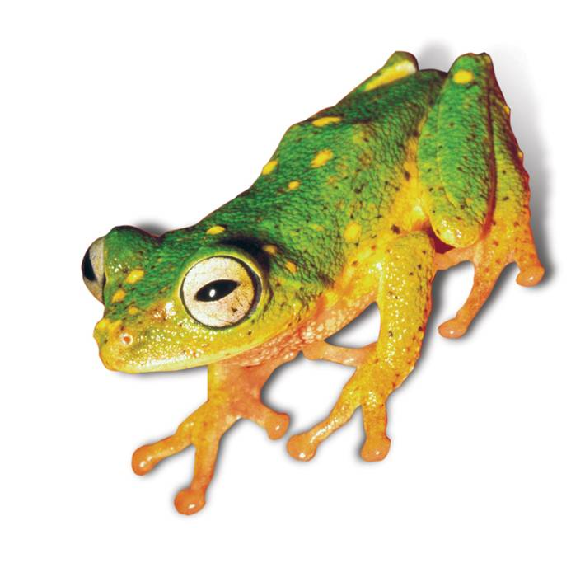
Preserving biodiversity is important to the future of the biosphere.
The loss of biodiversity has long-term effects.
loss of medical and technological advances
extinction of species
loss of ecosystem stability

Slide 3
Loss of habitat eliminates species.
Habitat fragmentation prevents an organism from accessing its entire home range.
occurs when a barrier forms within the habitat
often caused by human development

Slide 4
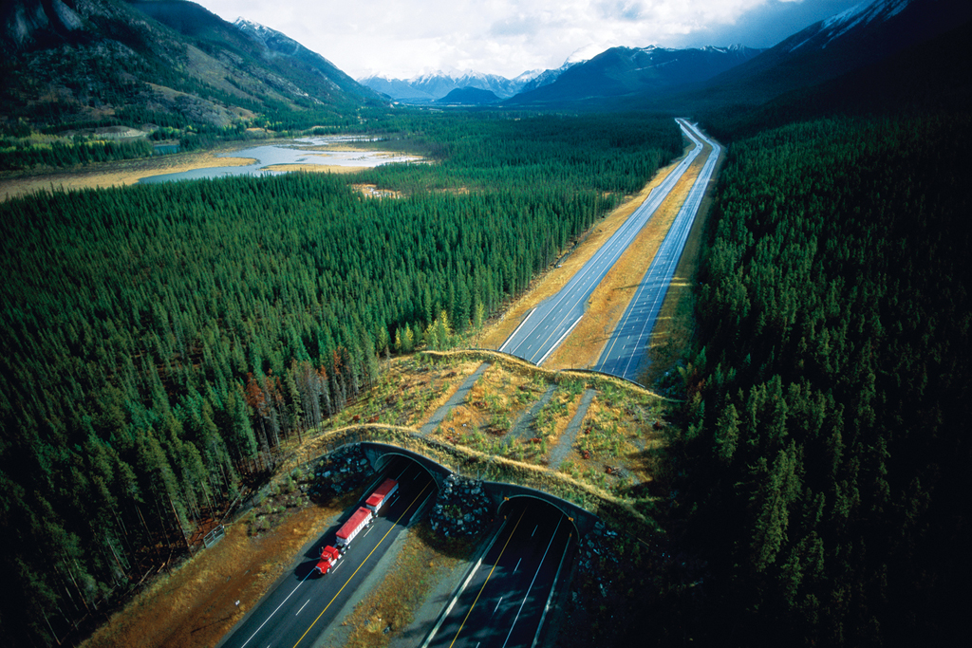
Habitat corridors are a solution to the problem.
corridors can be road overpasses or underpasses
allow species to move between different areas of habitat

Slide 5
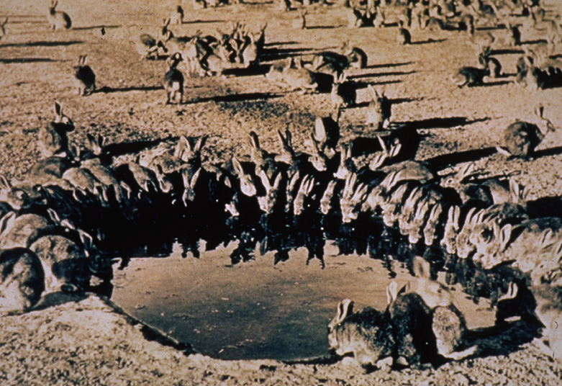
Introduced species can disrupt stable relationships in an ecosystem.
An introduced species is one that is brought to an ecosystem by humans.
accidental
purposeful
Invasive species can have an environmental and economic impact.

Slide 6
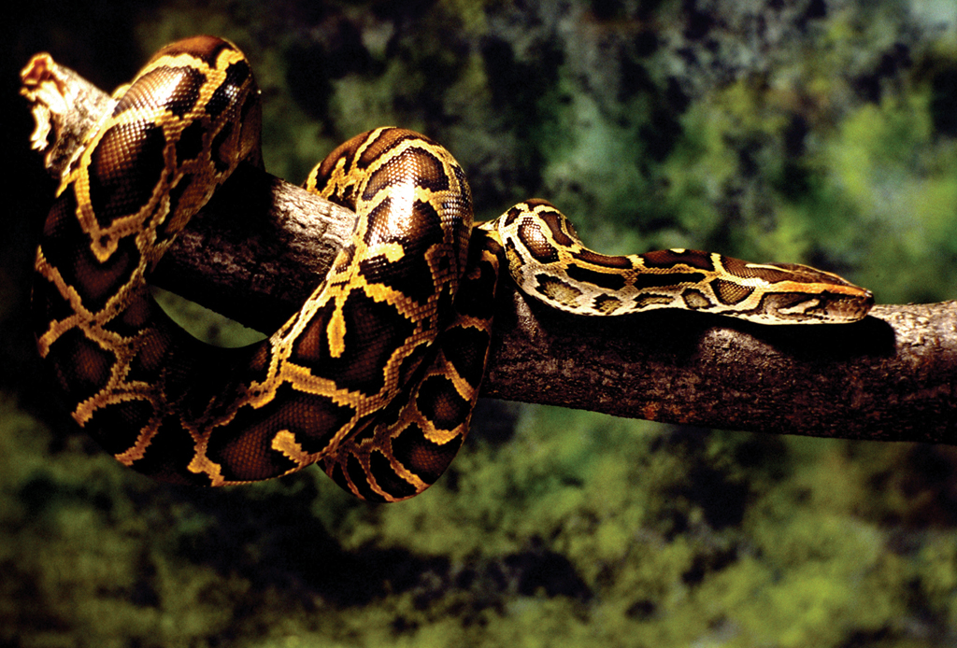
Invasive species often push out native species.
Burmese python (Florida Everglades)

Slide 7
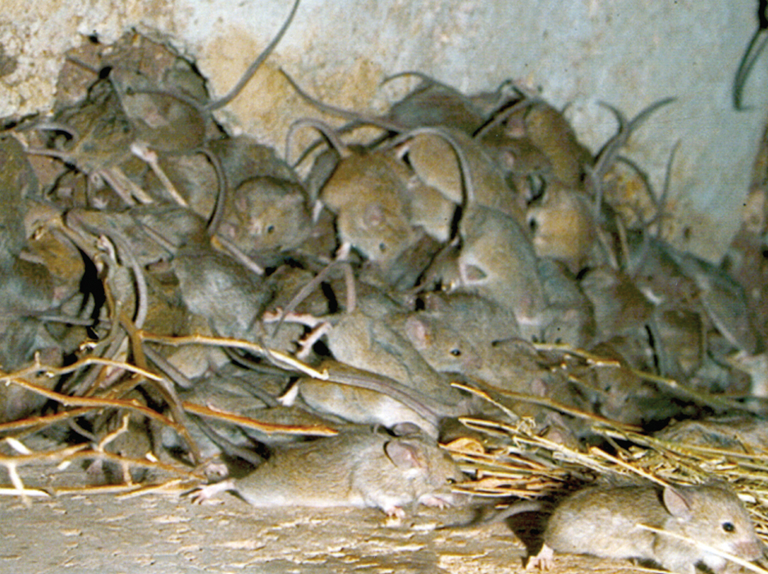
Invasive species often push out native species.
mice (Australia)

Slide 8
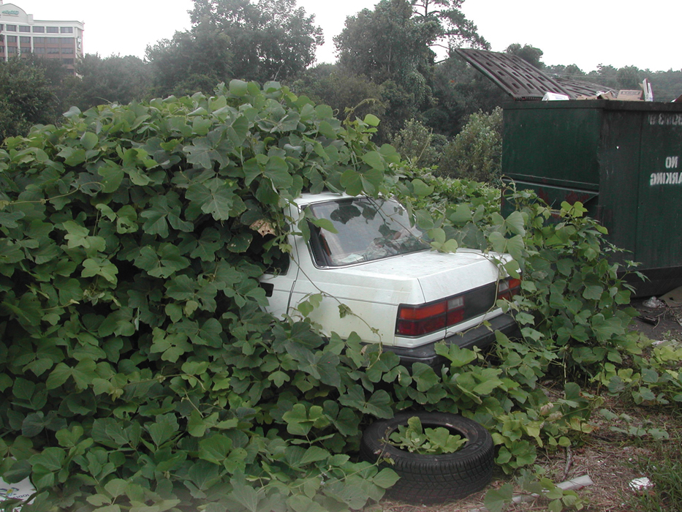
Invasive species often push out native species.
kudzu (southeastern United States)

