Slide 1
The Muscular System

Slide 2
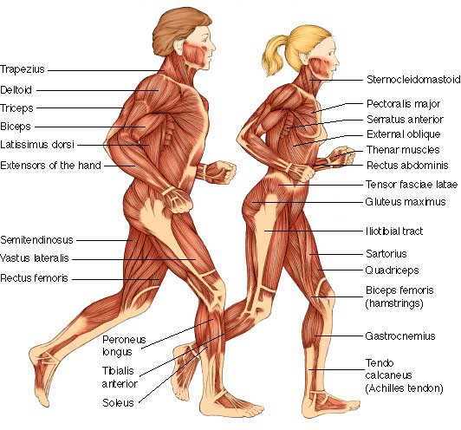
Functions of Muscles
Produce movement
Maintain posture
Stabilize joints
Generate heat

Slide 3
The Muscular System
Three basic muscle types are found in the body
  *Skeletal muscle
  Cardiac muscle
  Smooth muscle

Slide 4
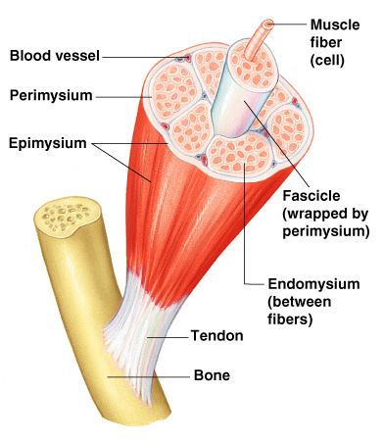
Connective Tissue Wrappings of Skeletal Muscle
Endomysium
  Wraps around single muscle fiber
Perimysium
  Wraps around a fascicle (bundle) of fibers
Figure 6.1

Slide 5
Connective Tissue Wrappings of Skeletal Muscle
Epimysium
  covers the entire skeletal muscle
Fascia
  outside the epimysium
Figure 6.1

Slide 6
Skeletal Muscle Attachments
Epimysium
    blends into a connective tissue attachment
  Tendon
    cord-like structure
  Aponeurosis
    sheet-like structure
Sites of muscle attachment
  Bones
  Cartilages
  Connective tissue coverings

Slide 7
Characteristics of Muscles
Muscle cells are elongated
(muscle cell = muscle fiber)
Contraction of muscles is due to the movement of microfilaments
All muscles share some terminology
  Prefix myo refers to muscle
  Prefix mys refers to muscle
  Prefix sarco refers to flesh

Slide 8
Skeletal Muscle Characteristics
Most are attached by tendons to bones
  Achilles
Cells are multinucleate
Striated
  Visible banding
Voluntary
  conscious control
Cells are surrounded and bundled by connective tissue

Slide 9
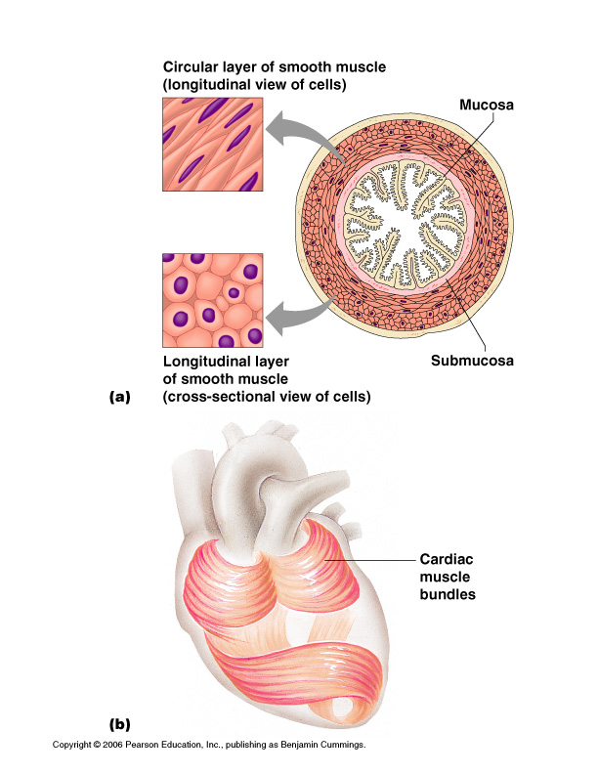
Smooth Muscle Characteristics
No striations
Spindle-shaped cells
Single nucleus
Involuntary
  no conscious control
Found mainly in the walls of hollow organs
Figure 6.2a

Slide 10
Cardiac Muscle Characteristics
Striations
Usually has a single nucleus
Joined to another muscle cell at an intercalated disc
Involuntary
Found only in the heart
Figure 6.2b

Slide 11
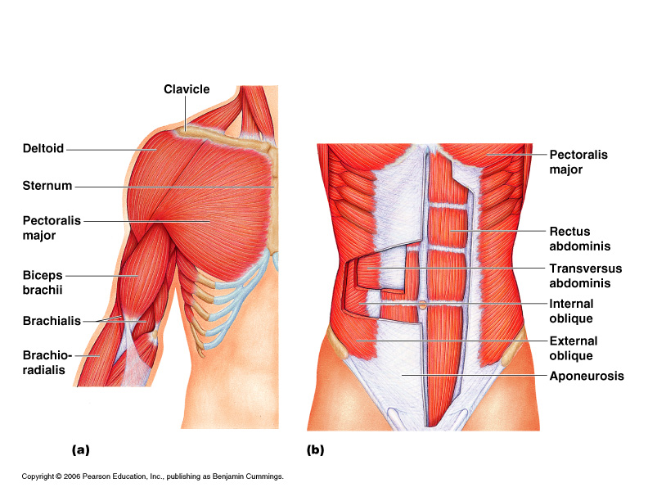
Naming Skeletal Muscles
Direction of muscle fibers
  rectus (straight)
Relative size of the muscle
  Maximus (largest)
  minimis (smallest)

Slide 12
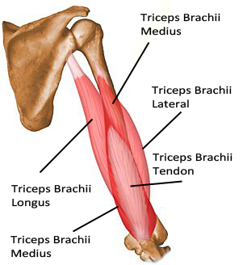
Naming of Skeletal Muscles
Location of the muscle
  muscles named for bones
    temporalis
Number of origins
  triceps (three heads)
  Origin
  attachment to bone that does NOT move
  Insertion
  attachment to bone that MOVES

Slide 13
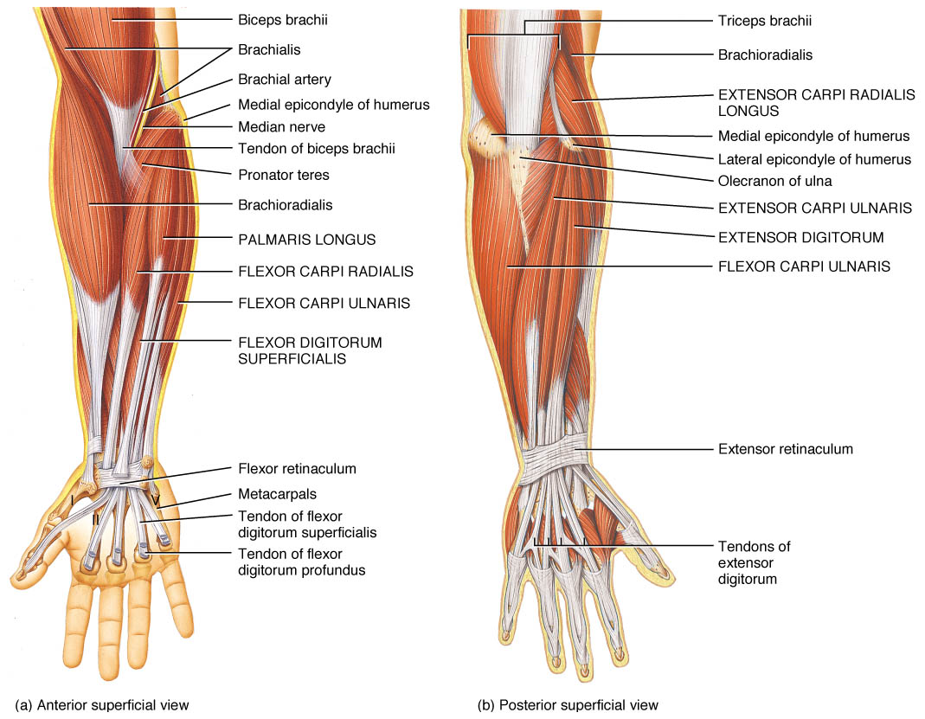
Naming of Skeletal Muscles
Location of the muscle’s origin and insertion
  sterno (on the sternum)
Shape of the muscle
  deltoid (triangular)
  Trapezius (trapezoid shaped)
Action of the muscle
  flexor and extensor (flexes or extends a bone)
e

Slide 14
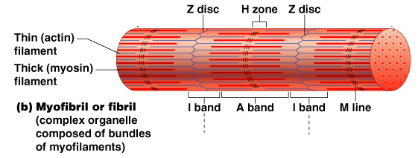
Microscopic Anatomy of Skeletal Muscle
Sarcomere
  Contractile unit of a muscle fiber
Figure 6.3b

Slide 15
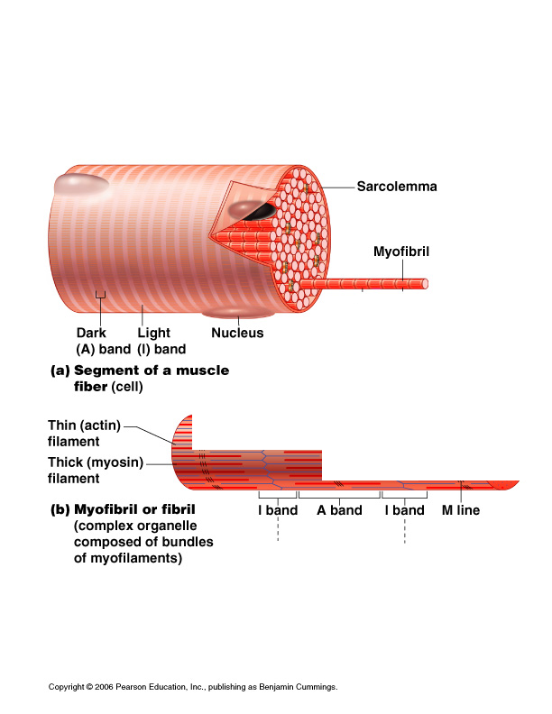
Microscopic Anatomy of Skeletal Muscle
Multinucleated cells
Nuclei are just beneath the sarcolemma
Figure 6.3a

Slide 16
Microscopic Anatomy of Skeletal Muscle
Sarcolemma
  specialized plasma membrane
Sarcoplasmic reticulum
  specialized smooth endoplasmic reticulum
Figure 6.3a

Slide 17
Microscopic Anatomy of Skeletal Muscle
Myofibril
  Bundles of myofilaments
  Myofibrils are aligned to give distinct bands
    I band
    light band
    A band
    dark band
Figure 6.3b

Slide 18
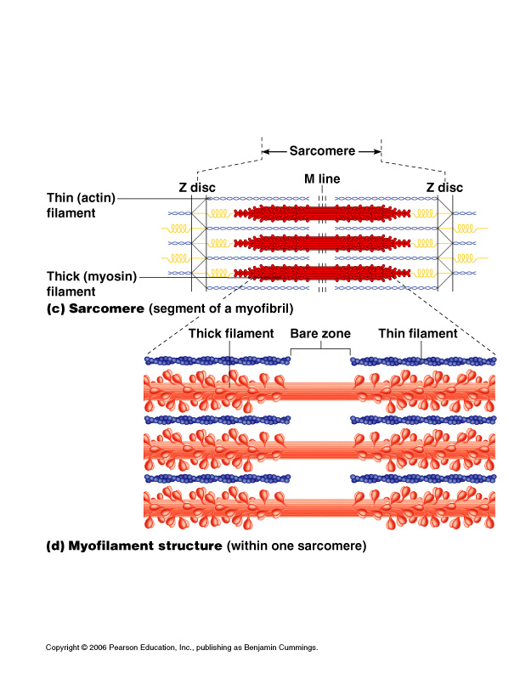
Microscopic Anatomy of Skeletal Muscle
Organization of the sarcomere
  Thick filaments
    Myosin filaments
    Composed of the protein myosin
    Has ATPase enzymes
Figure 6.3c

Slide 19
Microscopic Anatomy of Skeletal Muscle
Organization of the sarcomere
  Thin filaments
    Actin filaments
    Composed of the protein actin
Figure 6.3c

Slide 20
Microscopic Anatomy of Skeletal Muscle
Myosin filaments have heads (extensions, or cross bridges)
Myosin and actin overlap (slightly)
Figure 6.3d

Slide 21
Microscopic Anatomy of Skeletal Muscle
At rest, the bare zone that lacks actin filaments
Sarcoplasmic reticulum (SR) for storage of calcium
Figure 6.3d

Slide 22
Properties of Skeletal Muscle Activity
Irritability
  ability to receive and respond to a stimulus
Contractility
  ability to shorten when an adequate stimulus is received

Slide 23
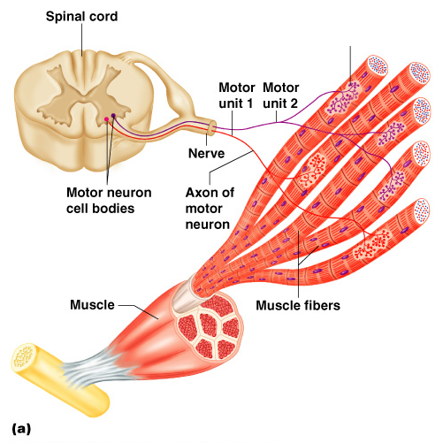
Nerve Stimulus to Muscles
Skeletal muscles must be stimulated by a nerve to contract
Motor unit
  One neuron
  Muscle cells stimulated by that neuron
Figure 6.4a

Slide 24
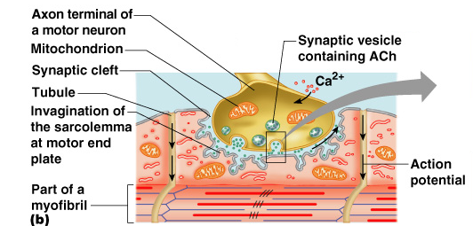
Nerve Stimulus to Muscles
Neuromuscular junctions – association site of nerve and muscle
Figure 6.5b

Slide 25
Nerve Stimulus to Muscles
Synaptic cleft
    gap between nerve and muscle
  Nerve and muscle do not make contact
  Area between nerve and muscle is filled with interstitial fluid
Figure 6.5b

Slide 26
Transmission of Nerve Impulse to Muscle
Neurotransmitter – chemical released by nerve upon arrival of nerve impulse
  The neurotransmitter for skeletal muscle is acetylcholine
Neurotransmitter attaches to receptors on the sarcolemma
Sarcolemma becomes permeable to sodium (Na⁺)

Slide 27
Transmission of Nerve Impulse to Muscle

Slide 28
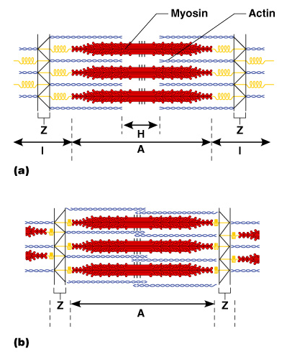
The Sliding Filament Theory of Muscle Contraction
Activation by nerve causes myosin heads (crossbridges) to attach to binding sites on the thin filament
Myosin heads then bind to the next site of the thin filament
Figure 6.7

Slide 29
The Sliding Filament Theory of Muscle Contraction
This continued action causes a sliding of the myosin along the actin
The result is that the muscle is shortened (contracted)
Figure 6.7

