Slide 2
Body Tissues
Tissues
Groups of cells with similar structure and function
Four primary types:
Epithelial tissue (epithelium)
Connective tissue
Muscle tissue
Nervous tissue

Slide 3
Epithelial Tissues
Locations:
Body coverings
Body linings
Glandular tissue
Functions:
Protection
Absorption
Filtration
Secretion

Slide 4
Epithelium Characteristics
Cells fit closely together and often form sheets
The apical surface is the free surface of the tissue
The lower surface of the epithelium rests on a basement membrane
Avascular (no blood supply)
Regenerate easily if well nourished

Slide 5
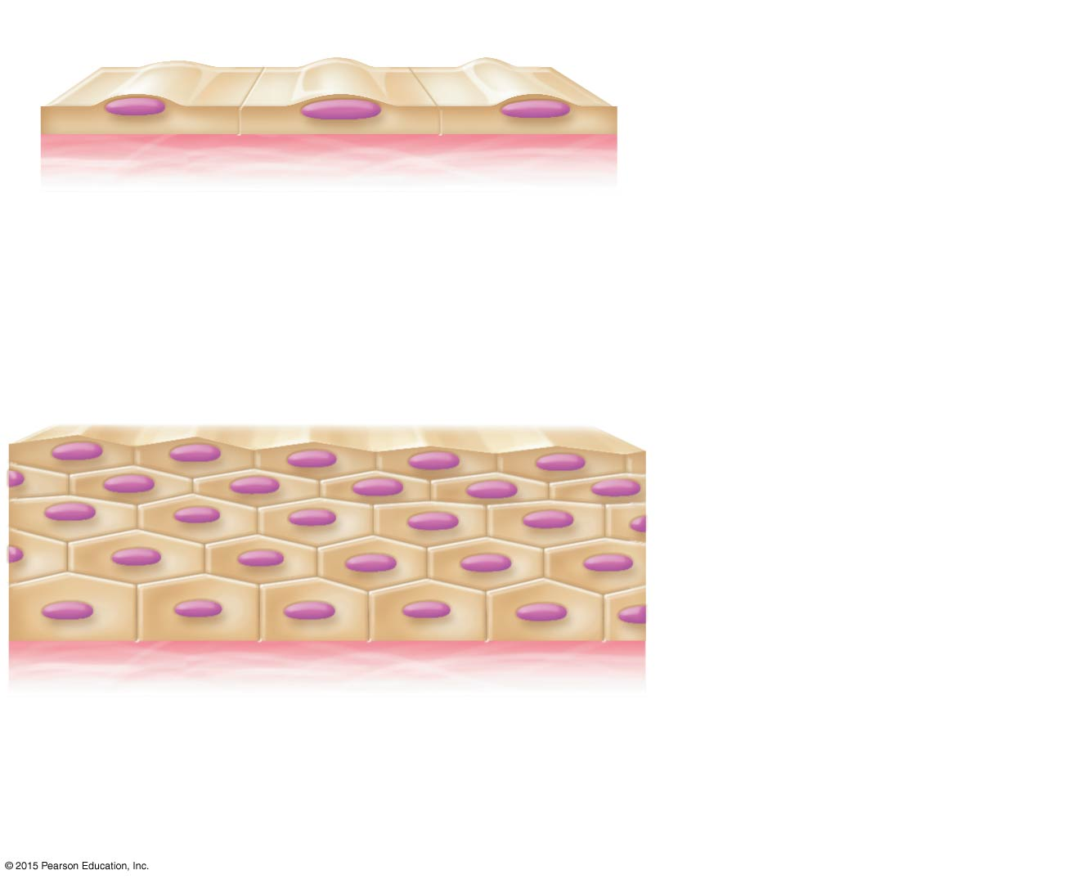
Figure 3.17a Classification and functions of epithelia.
Apical surface
Basal surface
Simple
Apical surface
Basal surface
Stratified
(a) Classification based on number of cell layers

Slide 6
Classification of Epithelia
Number of cell layers
Simple—one layer
Stratified—more than one layer

Slide 7
Figure 3.17a Classification and functions of epithelia.
Apical surface
Basal surface
Simple
Apical surface
Basal surface
Stratified
(a) Classification based on number of cell layers

Slide 8
Classification of Epithelia
Shape of cells
Squamous
Flattened, like fish scales
Cuboidal
Cube-shaped, like dice
Columnar
Column-like

Slide 9
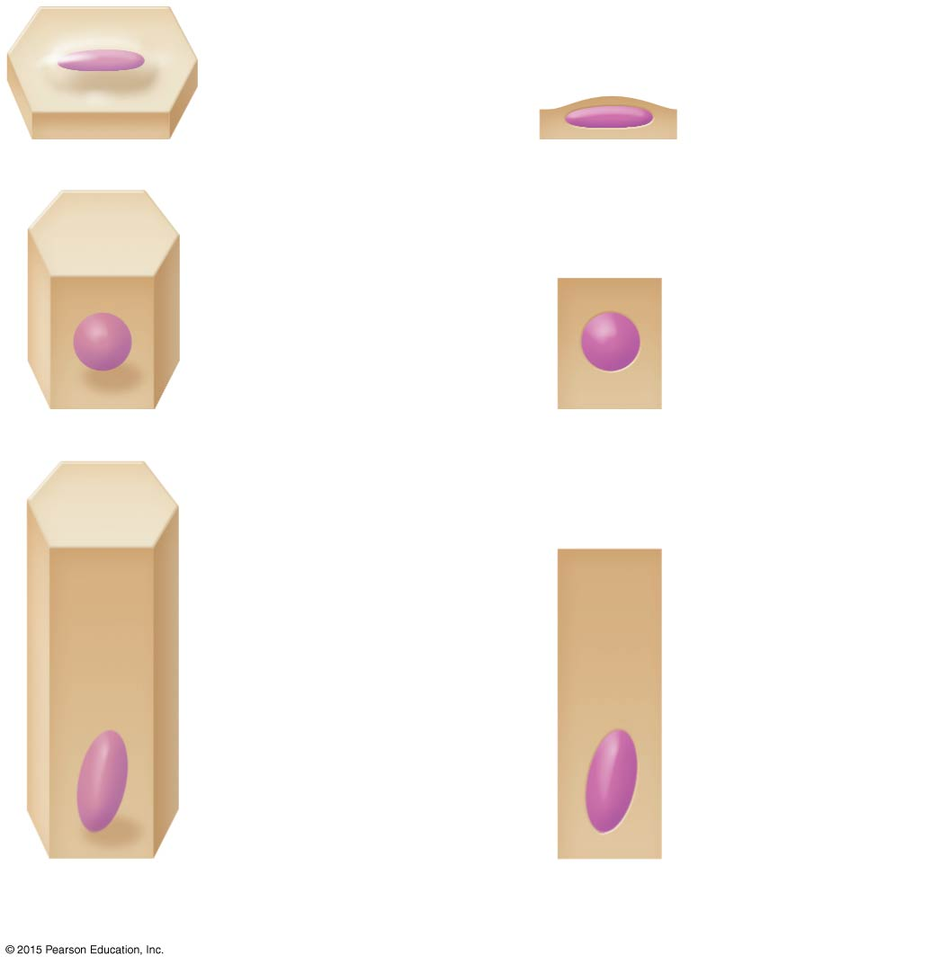
Figure 3.17b Classification and functions of epithelia.
Squamous
Cuboidal
Columnar
(b) Classification based on cell shape

Slide 10
Figure 3.17c Classification and functions of epithelia.
Number of layers
One layer: simple epithelial tissues
More than one layer: stratified epithelial tissues
Cell shape
Squamous
Diffusion and filtration Secretion in serous membranes
Protection
Cuboidal
Secretion and absorption; ciliated types propel mucus or reproductive cells
Protection; these tissue types are rare in humans
Columnar
Secretion and absorption; ciliated types propel mucus or reproductive cells
Transitional
Protection; stretching to accommodate distension of urinary structures
(c) Function of epithelial tissue related to tissue type

Slide 11
Simple Epithelia
Simple squamous
Single layer of flat cells
Location—usually forms membranes
Lines air sacs of the lungs
Forms walls of capillaries
Forms serous membranes (serosae) that line and cover organs in ventral cavity
Functions in diffusion, filtration, or secretion in membranes

Slide 12
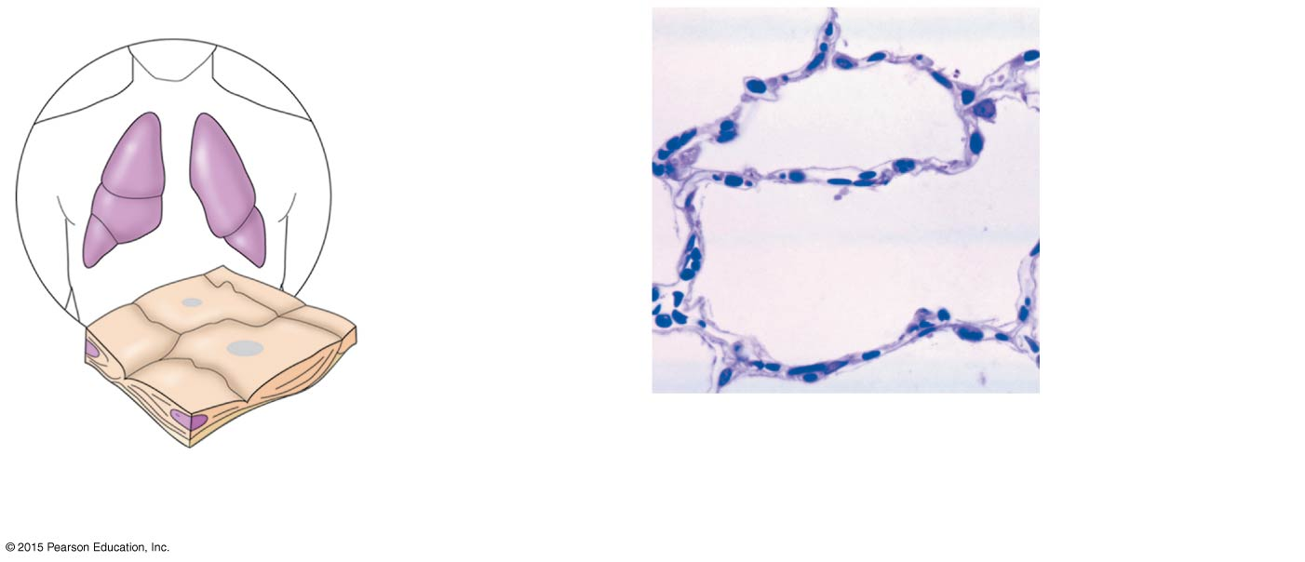
Figure 3.18a Types of epithelia and their common locations in the body.
Air sacs of lungs
Nucleus of squamous epithelial cell
Nuclei of squamous epithelial cells
Basement membrane
Photomicrograph: Simple squamous epithelium forming part of the alveolar (air sac) walls (275×).
(a) Diagram: Simple squamous

Slide 13
Simple Epithelia
Simple cuboidal
Single layer of cube-like cells
Locations:
Common in glands and their ducts
Forms walls of kidney tubules
Covers the surface of ovaries
Functions in secretion and absorption; ciliated types propel mucus or reproductive cells

Slide 14
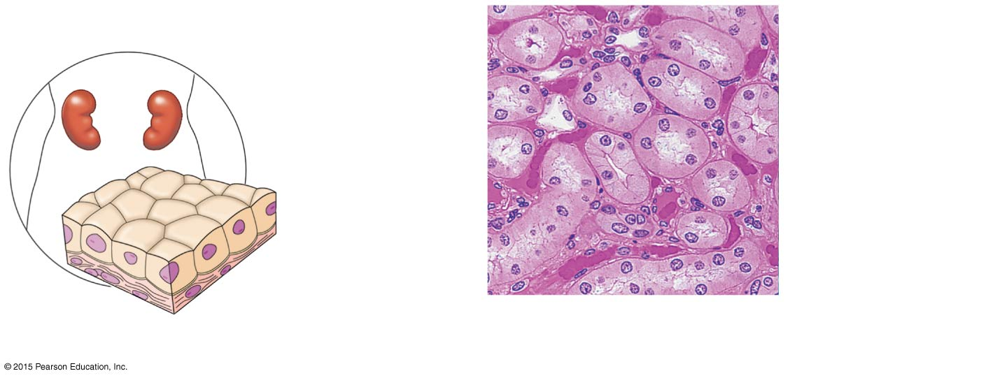
Figure 3.18b Types of epithelia and their common locations in the body.
Nucleus of simple cuboidal epithelial cell
Simple cuboidal epithelial cells
Basement membrane
Basement membrane
Connective tissue
(b) Diagram: Simple cuboidal
Photomicrograph: Simple cuboidal epithelium in kidney tubules (250×).

Slide 15
Simple Epithelia
Simple columnar
Single layer of tall cells
Goblet cells secrete mucus
Location:
Lines digestive tract from stomach to anus
Mucous membranes (mucosae) line body cavities opening to the exterior
Functions in secretion and absorption; ciliated types propel mucus or reproductive cells

Slide 16
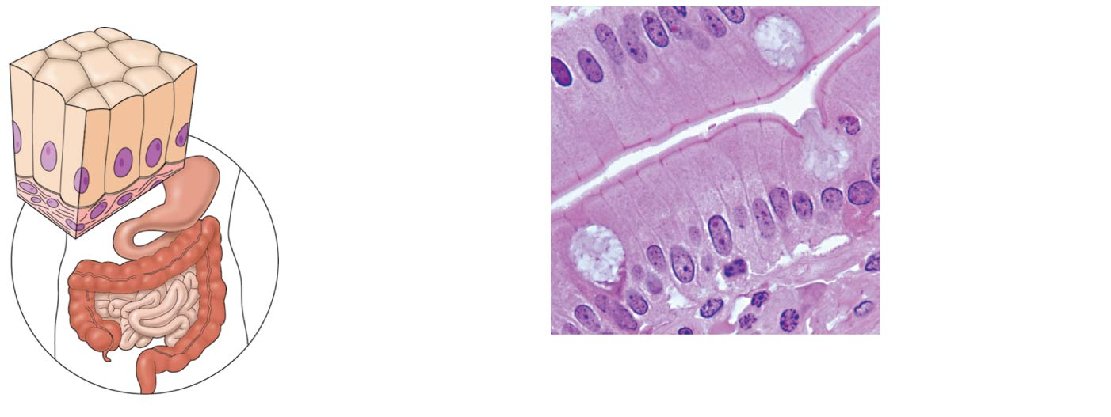
Figure 3.18c Types of epithelia and their common locations in the body.
Mucus of a goblet cell
Nucleus of simple columnar epithelial cell
Simple columnar epithelial cells
Basement membrane
Basement membrane
Photomicrograph: Simple columnar epithelium of the small intestine (575×).
(c) Diagram: Simple columnar

Slide 17
Simple Epithelia
Pseudostratified columnar
All cells rest on a basement membrane
Single layer, but some cells are shorter than others giving a false (pseudo) impression of stratification
Location:
Respiratory tract, where it is ciliated and known as pseudostratified ciliated columnar epithelium
Functions in absorption or secretion

Slide 18
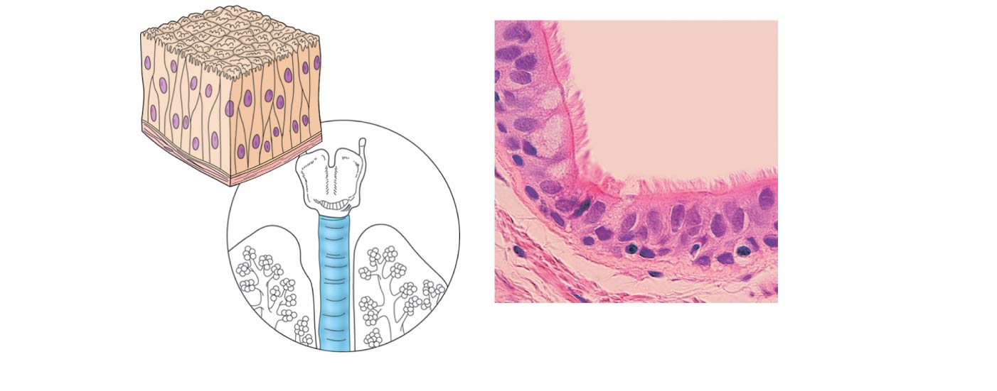
Figure 3.18d Types of epithelia and their common locations in the body.
Cilia
Pseudo- stratified epithelial layer
Pseudo- stratified epithelial layer
Basement membrane
Basement membrane
Connective tissue
Photomicrograph: Pseudostratified ciliated columnar epithelium lining the human trachea (560×).
(d) Diagram: Pseudostratified (ciliated) columnar

Slide 19
Stratified Epithelia
Stratified squamous
Named for cells present at the free (apical) surface, which are flattened
Functions as a protective covering where friction is common
Locations—lining of the:
Skin (outer portion)
Mouth
Esophagus

Slide 20
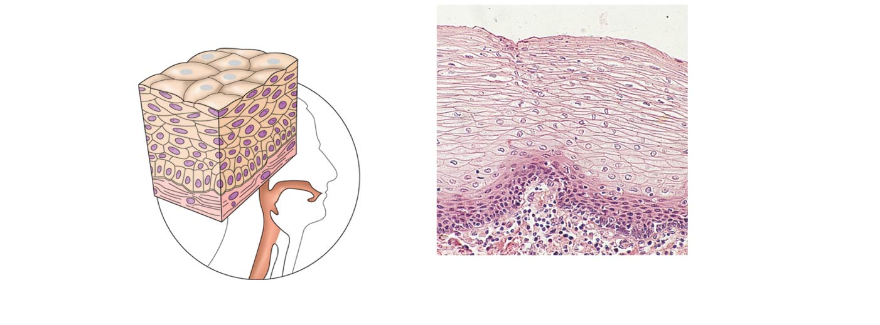
Figure 3.18e Types of epithelia and their common locations in the body.
Nuclei
Stratified squamous epithelium
Stratified squamous epithelium
Basement membrane
Basement membrane
Connective tissue
Photomicrograph: Stratified squamous epithelium lining of the esophagus (140×).
(e) Diagram: Stratified squamous

Slide 21
Stratified Epithelia
Stratified cuboidal—two layers of cuboidal cells; functions in protection
Stratified columnar—surface cells are columnar, and cells underneath vary in size and shape; functions in protection
Stratified cuboidal and columnar
Rare in human body
Found mainly in ducts of large glands

Slide 22
Stratified Epithelia
Transitional epithelium
Composed of modified stratified squamous epithelium
Shape of cells depends upon the amount of stretching
Functions in stretching and the ability to return to normal shape
Locations: urinary system organs

Slide 23
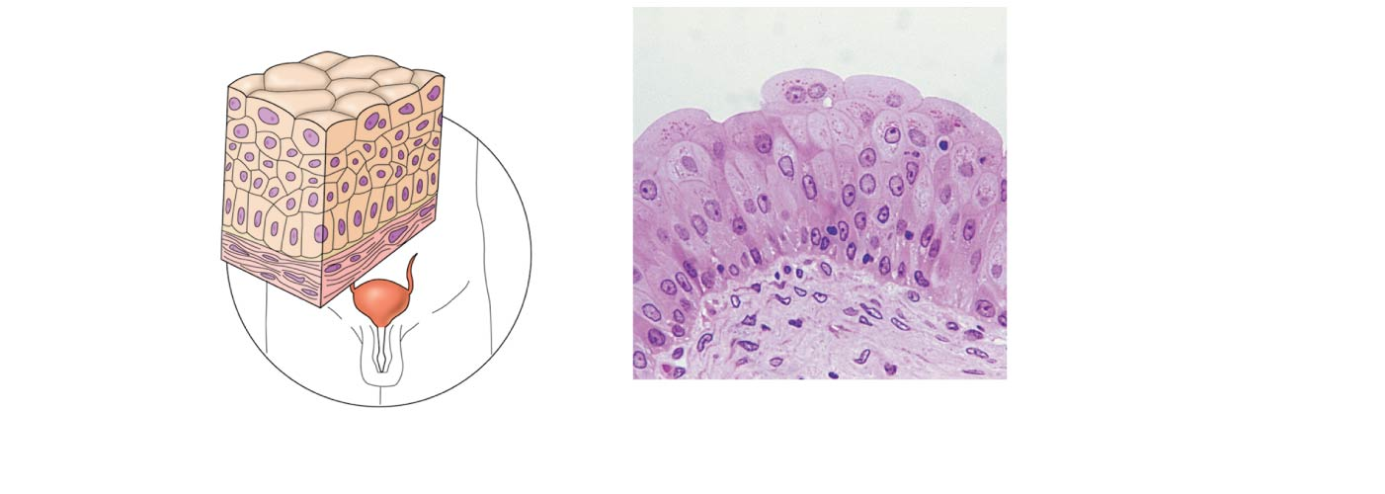
Figure 3.18f Types of epithelia and their common locations in the body.
Basement membrane
Transi- tional epithelium
Transitional epithelium
Basement membrane
Connective tissue
Photomicrograph: Transitional epithelium lining of the bladder, relaxed state (270×); surface rounded cells flatten and elongate when the bladder fills with urine.
(f) Diagram: Transitional

Slide 24
Glandular Epithelium
Gland
One or more cells responsible for secreting a particular product
Secretions contain protein molecules in an aqueous (water-based) fluid
Secretion is an active process

Slide 25
Glandular Epithelium
Two major gland types
Endocrine gland
Ductless; secretions diffuse into blood vessels
All secretions are hormones
Examples include thyroid, adrenals, and pituitary

Slide 26
Glandular Epithelium
Two major gland types
Exocrine gland
Secretions empty through ducts to the epithelial surface
Include sweat and oil glands, liver, and pancreas
Includes both internal and external glands

Slide 27
Connective Tissue
Found everywhere in the body
Includes the most abundant and widely distributed tissues
Functions:
Provides protection
Binds body tissues together
Supports the body

Slide 28
Connective Tissue Characteristics
Variations in blood supply
Some tissue types are well vascularized
Some have a poor blood supply or are avascular
Extracellular matrix
Nonliving material that surrounds living cells

Slide 29
Extracellular Matrix
Two main elements
Ground substance—mostly water along with adhesion proteins and polysaccharide molecules
Fibers
Produced by the cells
Three types:
Collagen (white) fibers
Elastic (yellow) fibers
Reticular fibers (a type of collagen)

Slide 30
Connective Tissue Types
From most rigid to softest, or most fluid:
Bone
Cartilage
Dense connective tissue
Loose connective tissue
Blood

Slide 31
Connective Tissue Types
Bone (osseous tissue)
Composed of:
Osteocytes (bone cells) sitting in lacunae (cavities)
Hard matrix of calcium salts
Large numbers of collagen fibers
Functions to protect and support the body

Slide 32
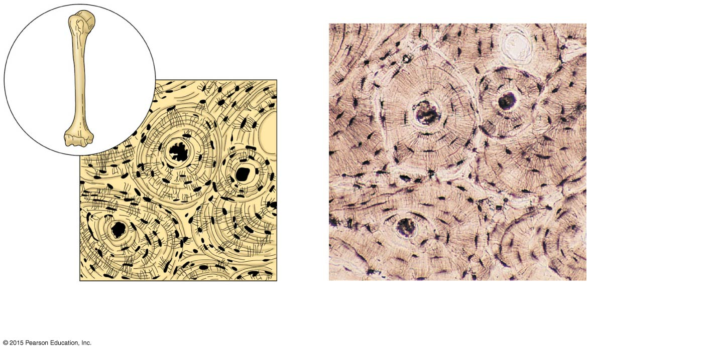
Figure 3.19a Connective tissues and their common body locations.
Bone cells in lacunae
Central canal
Lacunae
Lamella
(a) Diagram: Bone
Photomicrograph: Cross-sectional view of ground bone (165×)

Slide 33
Connective Tissue Types
Cartilage
Less hard and more flexible than bone
Found in only a few places in the body
Chondrocyte (cartilage cell) is the major cell type

Slide 34
Connective Tissue Types
Hyaline cartilage
Hyaline cartilage is the most widespread type of cartilage
Composed of abundant collagen fibers and a rubbery matrix
Locations:
Larynx
Entire fetal skeleton prior to birth
Epiphyseal plates
Functions as a more flexible skeletal element than bone

Slide 35
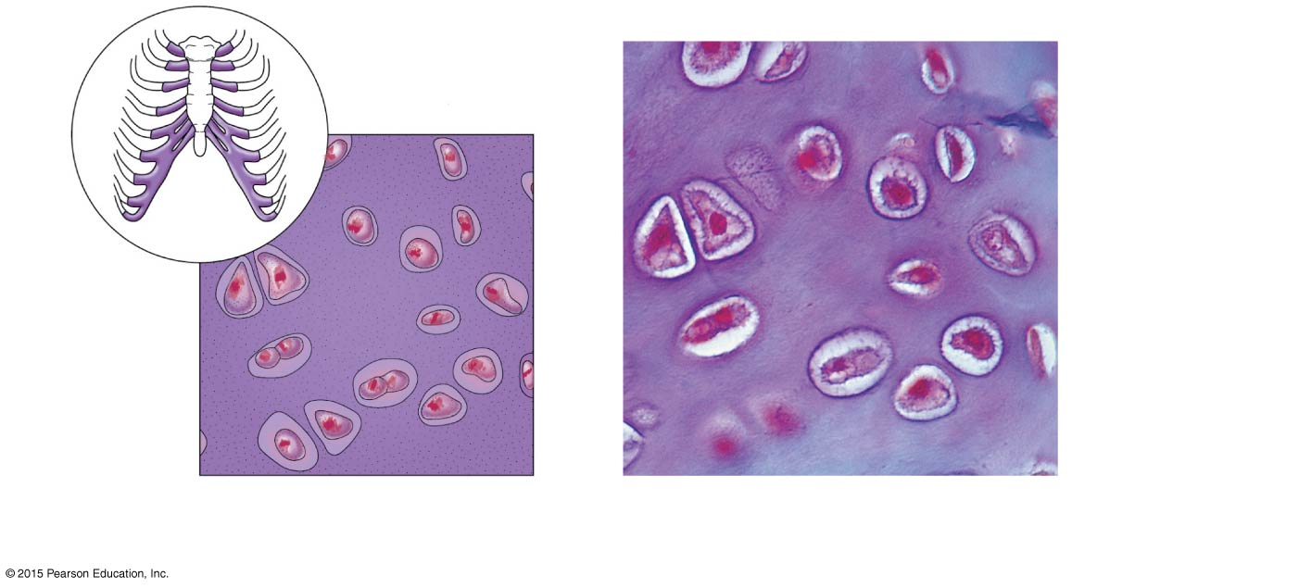
Figure 3.19b Connective tissues and their common body locations.
Chondrocyte (cartilage cell)
Chondrocyte in lacuna
Lacunae
Matrix
(b) Diagram: Hyaline cartilage
Photomicrograph: Hyaline cartilage from the trachea (400×)

Slide 36
Connective Tissue Types
Elastic cartilage (not pictured)
Provides elasticity
Location:
Supports the external ear
Fibrocartilage
Highly compressible
Location:
Forms cushionlike discs between vertebrae of the spinal column

Slide 37
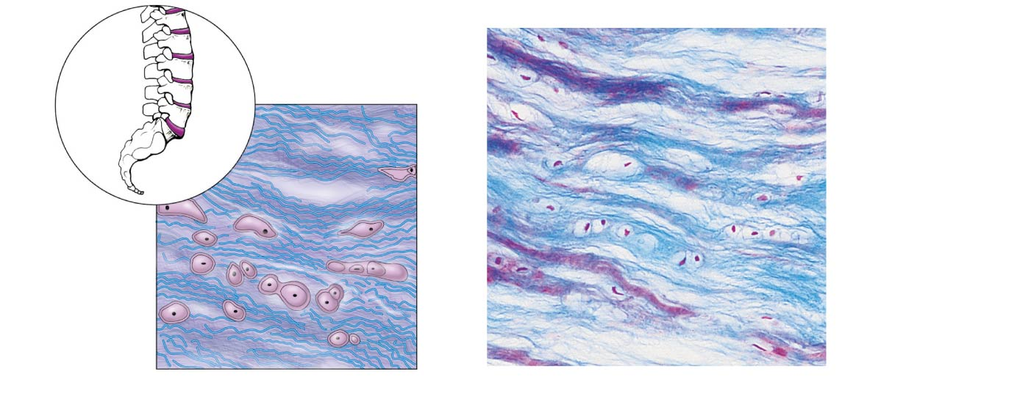
Figure 3.19c Connective tissues and their common body locations.
Chondrocytes in lacunae
Chondro- cytes in lacunae
Collagen fiber
Collagen fibers
(c) Diagram: Fibrocartilage
Photomicrograph: Fibrocartilage of an intervertebral disc (150×)

Slide 38
Connective Tissue Types
Dense connective tissue (dense fibrous tissue)
Main matrix element is collagen fiber
Fibroblasts are cells that make fibers
Locations:
Tendons—attach skeletal muscle to bone
Ligaments—attach bone to bone at joints and are more elastic than tendons
Dermis—lower layers of the skin

Slide 39
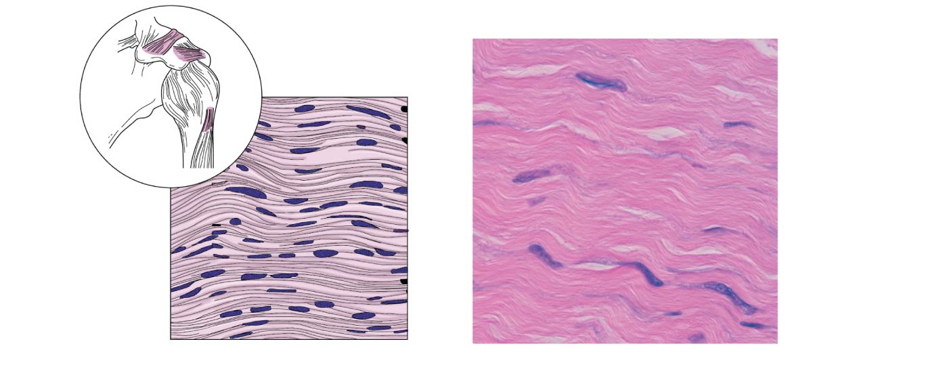
Figure 3.19d Connective tissues and their common body locations.
Ligament
Tendon
Collagen fibers
Collagen fibers
Nuclei of fibroblasts
Nuclei of fibroblasts
(d) Diagram: Dense fibrous
Photomicrograph: Dense fibrous connective tissue from a tendon (475×)

Slide 40
Connective Tissue Types
Loose connective tissue types
Areolar tissue
Most widely distributed connective tissue
Soft, pliable tissue like “cobwebs”
Functions as a universal packing tissue and “glue” to hold organs in place
Layer of areolar tissue called lamina propria underlies all membranes
All fiber types form a loose network
Can soak up excess fluid (causes edema)

Slide 41
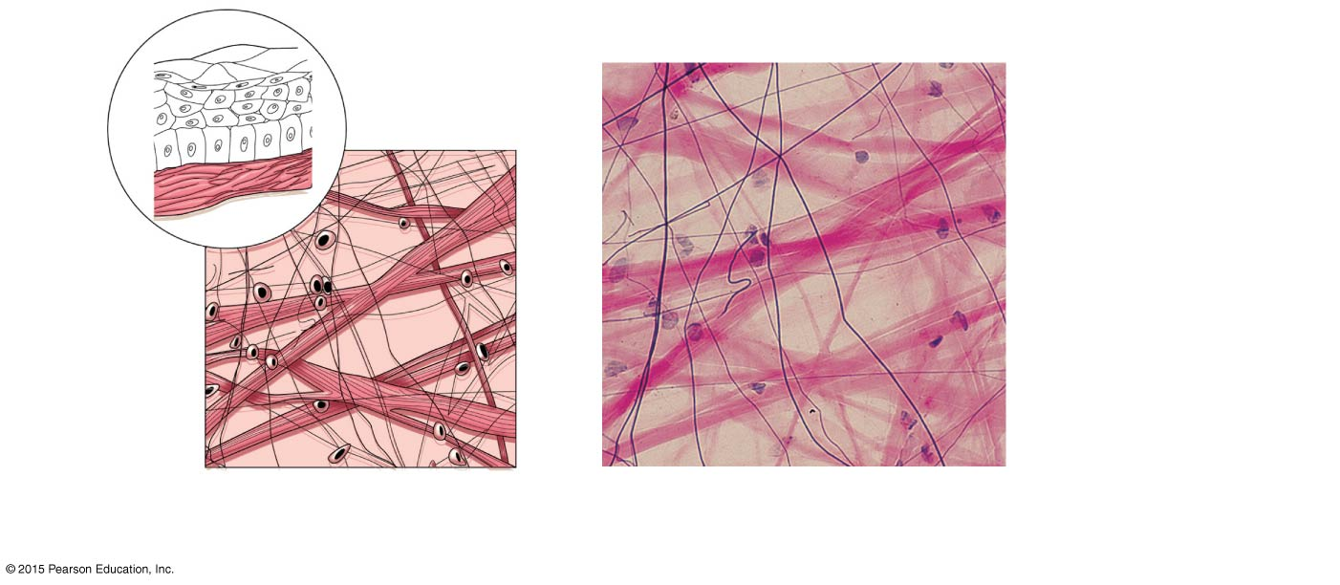
Figure 3.19e Connective tissues and their common body locations.
Mucosa epithelium
Lamina propria
Elastic fibers
Collagen fibers
Fibers of matrix
Fibroblast nuclei
Nuclei of fibroblasts
(e) Diagram: Areolar
Photomicrograph: Areolar connective tissue, a soft packaging tissue of the body (270×)

Slide 42
Connective Tissue Types
Loose connective tissue types
Adipose tissue
Matrix is an areolar tissue in which fat globules predominate
Many cells contain large lipid deposits with nucleus to one side (signet ring cells)
Functions
Insulates the body
Protects some organs
Serves as a site of fuel storage

Slide 43
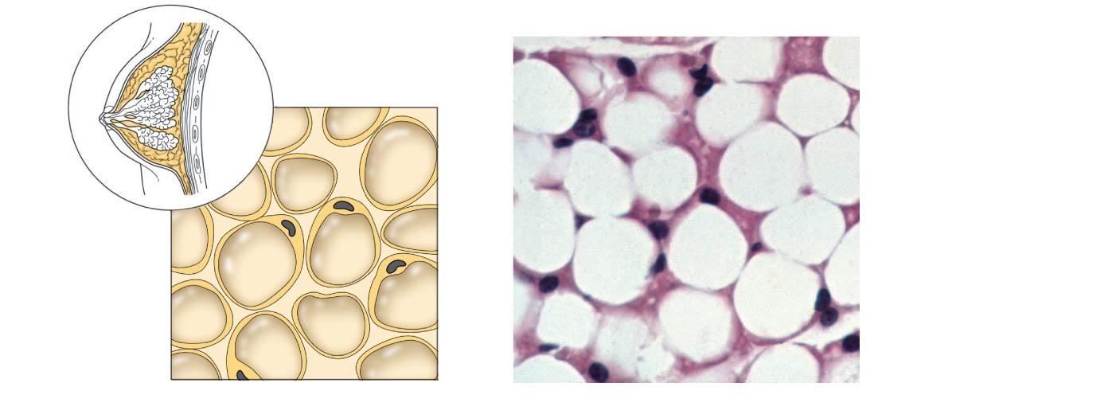
Figure 3.19f Connective tissues and their common body locations.
Nuclei of fat cells
Vacuole containing fat droplet
Nuclei of fat cells
Vacuole containing fat droplet
(f) Diagram: Adipose
Photomicrograph: Adipose tissue from the subcutaneous layer beneath the skin (570×)

Slide 44
Connective Tissue Types
Loose connective tissue types
Reticular connective tissue
Delicate network of interwoven fibers with reticular cells (like fibroblasts)
Locations:
Forms stroma (internal framework) of organs, such as these lymphoid organs:
Lymph nodes
Spleen
Bone marrow

Slide 45
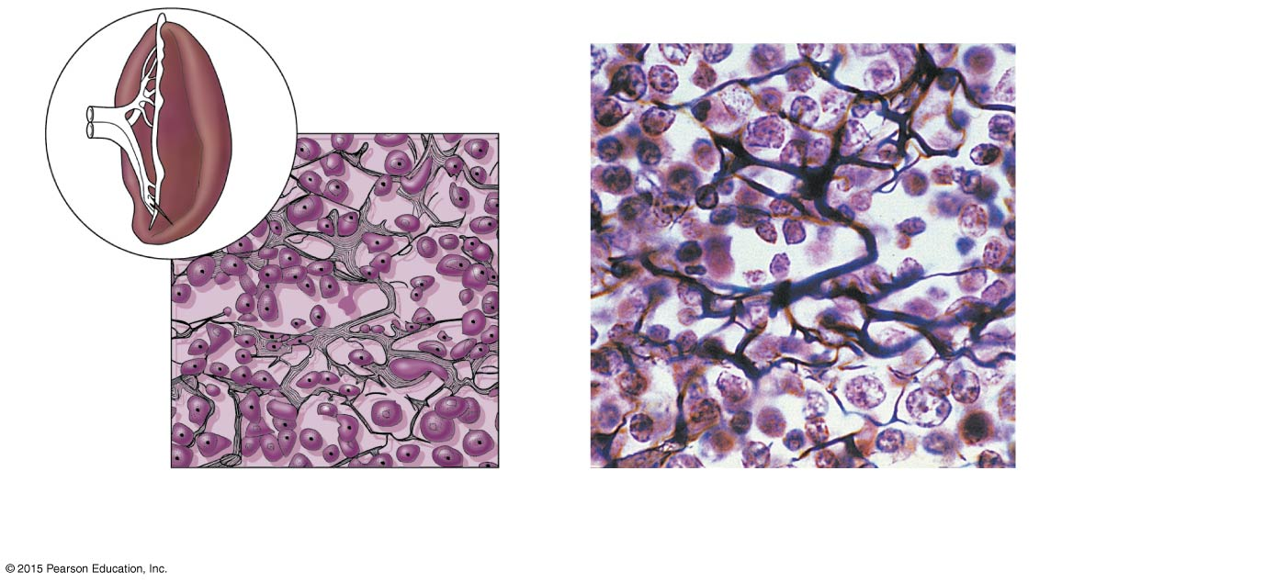
Figure 3.19g Connective tissues and their common body locations.
Spleen
White blood cell (lymphocyte)
Reticular cell
Reticular fibers
Blood cell
Reticular fibers
(g) Diagram: Reticular
Photomicrograph: Dark-staining network of reticular connective tissue (400×)

Slide 46
Connective Tissue Types
Blood (vascular tissue)
Blood cells surrounded by fluid matrix known as blood plasma
Soluble fibers are visible only during clotting
Functions as the transport vehicle for the cardiovascular system, carrying:
Nutrients
Wastes
Respiratory gases

Slide 47
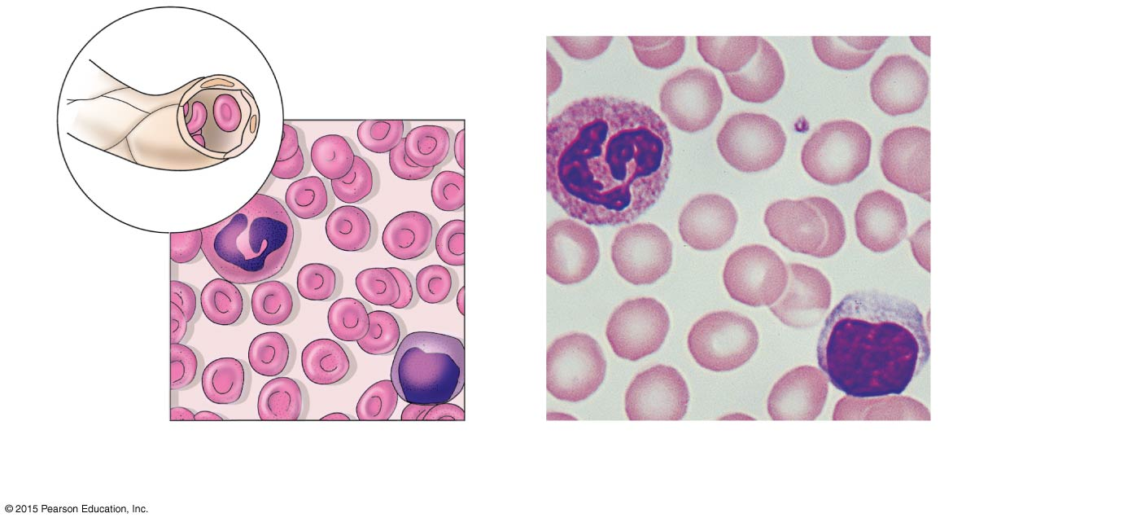
Figure 3.19h Connective tissues and their common body locations.
Blood cells in capillary
Neutrophil (white blood cell)
White blood cell
Red blood cells
Monocyte (white blood cell)
Red blood cells
(h) Diagram: Blood
Photomicrograph: Smear of human blood (1290×)

Slide 48
Muscle Tissue
Function is to contract, or shorten, to produce movement
Three types:
Skeletal muscle
Cardiac muscle
Smooth muscle

Slide 49
Muscle Tissue Types
Skeletal muscle
Voluntarily (consciously) controlled
Attached to the skeleton and pull on bones or skin
Produces gross body movements or facial expressions
Characteristics of skeletal muscle cells
Striations (stripes)
Multinucleate (more than one nucleus)
Long, cylindrical shape

Slide 50
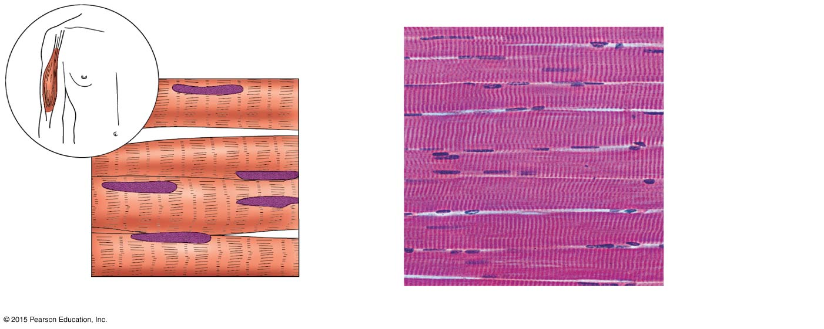
Figure 3.20a Type of muscle tissue and their common locations in the body.
Nuclei
Part of muscle fiber
(a) Diagram: Skeletal muscle
Photomicrograph: Skeletal muscle (195×)

Slide 51
Muscle Tissue Types
Cardiac muscle
Involuntarily controlled
Found only in the heart
Pumps blood through blood vessels
Characteristics of cardiac muscle cells
Striations
Uninucleate, short, branching cells
Intercalated discs contain gap junctions to connect cells together

Slide 52
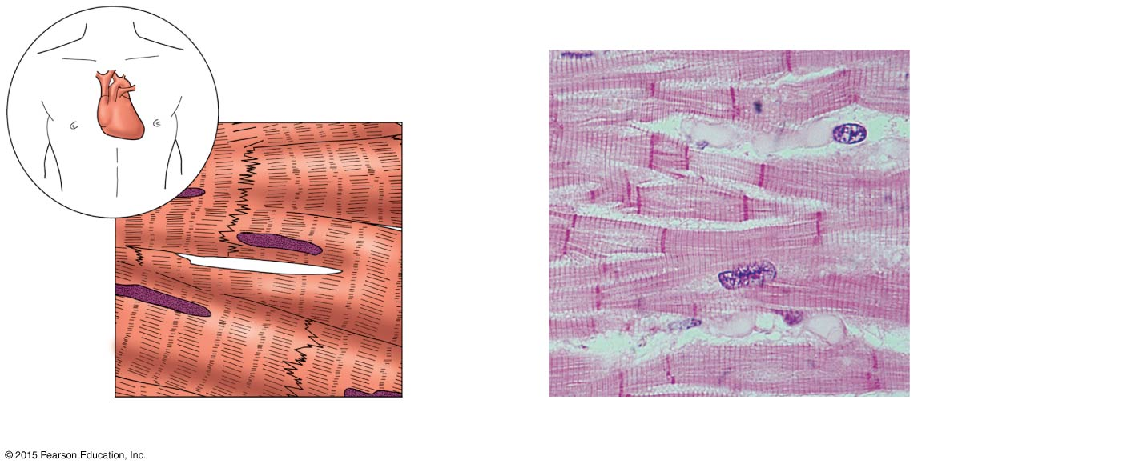
Figure 3.20b Type of muscle tissue and their common locations in the body.
Intercalated discs
Nucleus
(b) Diagram: Cardiac muscle
Photomicrograph: Cardiac muscle (475×)

Slide 53
Muscle Tissue Types
Smooth (visceral) muscle
Involuntarily controlled
Found in walls of hollow organs such as stomach, uterus, and blood vessels
Peristalsis, a wavelike activity, is a typical activity
Characteristics of smooth muscle cells
No visible striations
Uninucleate
Spindle-shaped cells

Slide 54
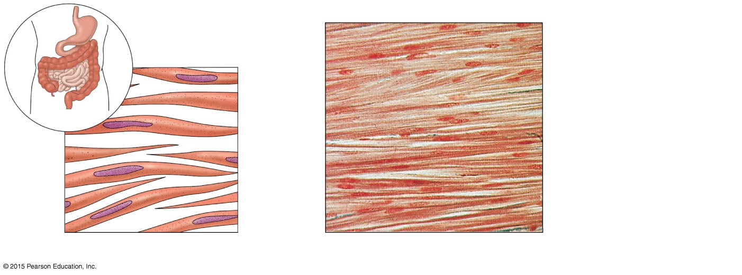
Figure 3.20c Type of muscle tissue and their common locations in the body.
Smooth muscle cell
Nuclei
(c) Diagram: Smooth muscle
Photomicrograph: Sheet of smooth muscle (285×)

Slide 55
Nervous Tissue
Composed of neurons and nerve support cells
Function is to receive and conduct electrochemical impulses to and from body parts
Irritability
Conductivity
Support cells called neuroglia insulate, protect, and support neurons

Slide 56
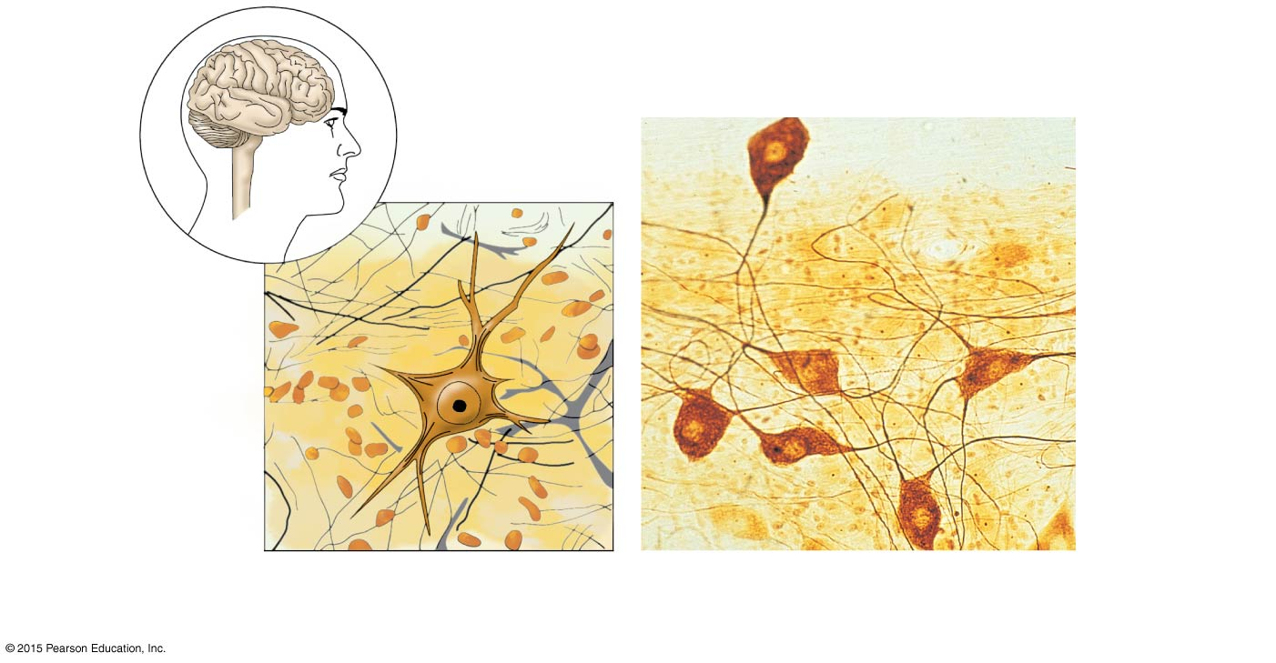
Figure 3.21 Nervous tissue.
Brain
Nuclei of supporting cells
Spinal cord
Nuclei of supporting cells
Cell body of neuron
Cell body of neuron
Neuron processes
Neuron processes
Diagram: Nervous tissue
Photomicrograph: Neurons (320×)

Slide 57
Summary of Tissues
Figure 3.22 summarizes the tissue types and functions in the body

Slide 58
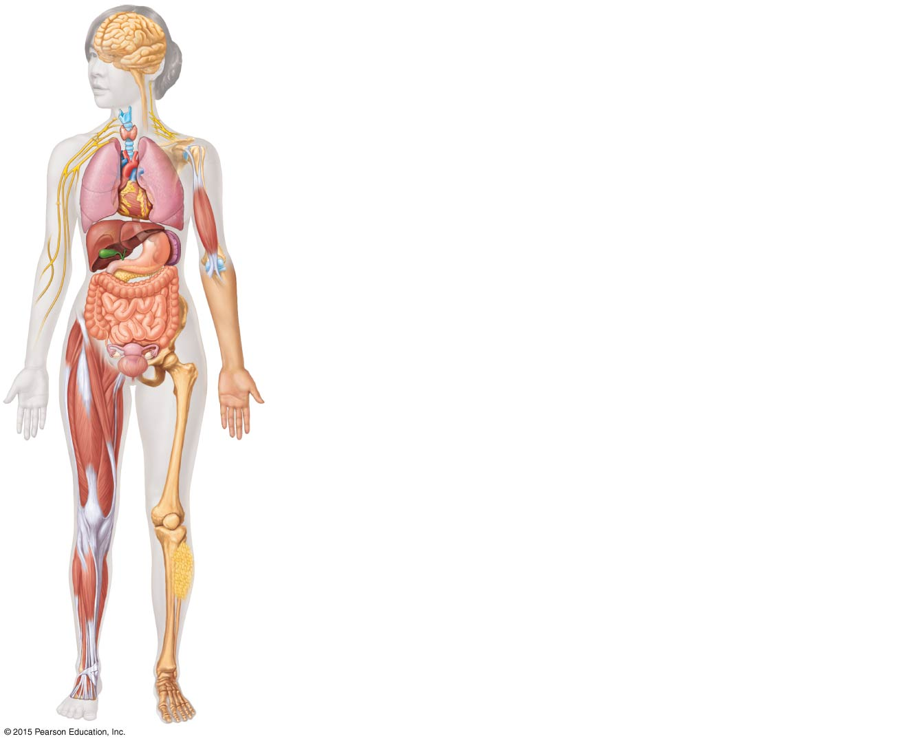
Figure 3.22 Summary of the major functions and body locations of the four tissue types: epithelial, connective, muscle, and nervous tissues.
Nervous tissue: Internal communication
• Brain, spinal cord, and nerves
Muscle tissue: Contracts to cause movement
• Muscles attached to bones (skeletal)
• Muscles of heart (cardiac)
• Muscles of walls of hollow organs (smooth)
Epithelial tissue: Forms boundaries between different environments, protects, secretes, absorbs, filters
• Lining of GI tract organs and other hollow organs
• Skin surface (epidermis)
Connective tissue: Supports, protects, binds other tissues together
• Bones
• Tendons
• Fat and other soft padding tissue

Slide 59
Tissue Repair (Wound Healing)
Tissue repair (wound healing) occurs in two ways:
Regeneration
Replacement of destroyed tissue by the same kind of cells
Fibrosis
Repair by dense (fibrous) connective tissue (scar tissue)

Slide 60
Tissue Repair (Wound Healing)
Whether regeneration or fibrosis occurs depends on:
Type of tissue damaged
Severity of the injury
Clean cuts (incisions) heal more successfully than ragged tears of the tissue

Slide 61
Events in Tissue Repair
Inflammation
Capillaries become very permeable
Clotting proteins migrate into the area from the bloodstream
A clot walls off the injured area
Granulation tissue forms
Growth of new capillaries
Phagocytes dispose of blood clot and fibroblasts
Rebuild collagen fibers

Slide 62
Events in Tissue Repair
Regeneration of surface epithelium
Scab detaches
Whether scar is visible or invisible depends on severity of wound

Slide 63
Regeneration of Tissues
Tissues that regenerate easily
Epithelial tissue (skin and mucous membranes)
Fibrous connective tissues and bone
Tissues that regenerate poorly
Skeletal muscle
Tissues that are replaced largely with scar tissue
Cardiac muscle
Nervous tissue within the brain and spinal cord

Slide 64
Development Aspects of Cells and Tissues
Growth through cell division continues through puberty
Cell populations exposed to friction (such as epithelium) replace lost cells throughout life
Connective tissue remains mitotic and forms repair (scar) tissue
With some exceptions, muscle tissue becomes amitotic by the end of puberty
Nervous tissue becomes amitotic shortly after birth.

Slide 65
Developmental Aspects of Cells and Tissues
Injury can severely handicap amitotic tissues
The cause of aging is unknown, but chemical and physical insults, as well as genetic programming, have been proposed as possible causes

Slide 66
Developmental Aspects of Cells and Tissues
Neoplasms, both benign and cancerous, represent abnormal cell masses in which normal controls on cell division are not working
Hyperplasia (increase in size) of a tissue or organ may occur when tissue is strongly stimulated or irritated
Atrophy (decrease in size) of a tissue or organ occurs when the organ is no longer stimulated normally

