Slide 1
KEY CONCEPT Pyramids model the distribution of energy and matter in an ecosystem.

Slide 2
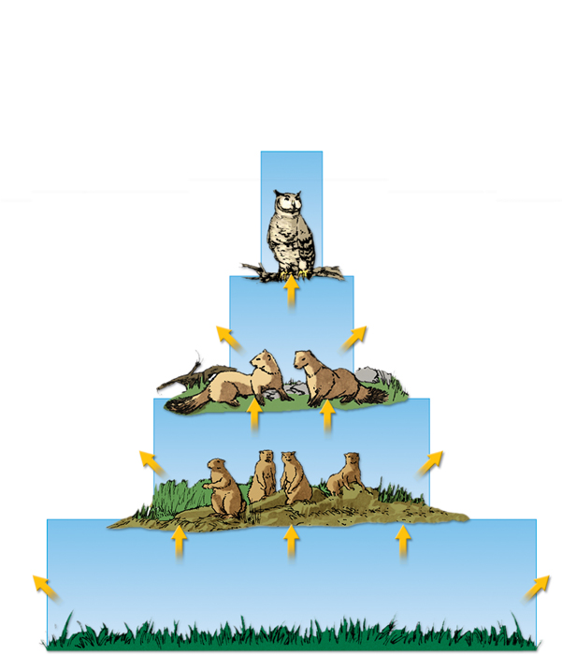
An energy pyramid shows the distribution of energy among trophic levels.
Energy pyramids compare energy used by producers and other organisms on trophic levels.
Between each tier of an energy pyramid, up to 90 percent of the energy is lost into the atmosphere as heat.
Only 10 percent of the energy at each tier is transferred from one trophic level to the next.
energy
lost
energy transferred

Slide 3
Other pyramid models illustrate an ecosystem’s biomass and distribution of organisms.
Biomass is a measure of the total dry mass of organisms in a given area.
tertiary
consumers
75 g/m2
150g/m2
secondary
consumers
primary
consumers
675g/m2
2000g/m2
producers
2000g/m2
producers

Slide 4
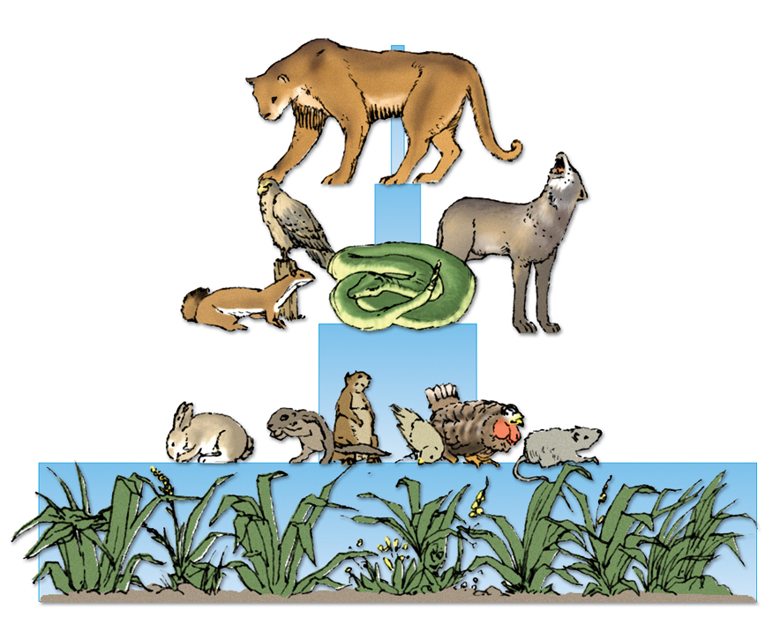
A pyramid of numbers shows the numbers of individual organisms at each trophic level in an ecosystem.
tertiary
consumers
5
secondary
consumers
5000
primary
consumers
500,000
producers
5,000,000
producers
5,000,000
A vast number of producers are required to support even a few top level consumers.

