Slide 1
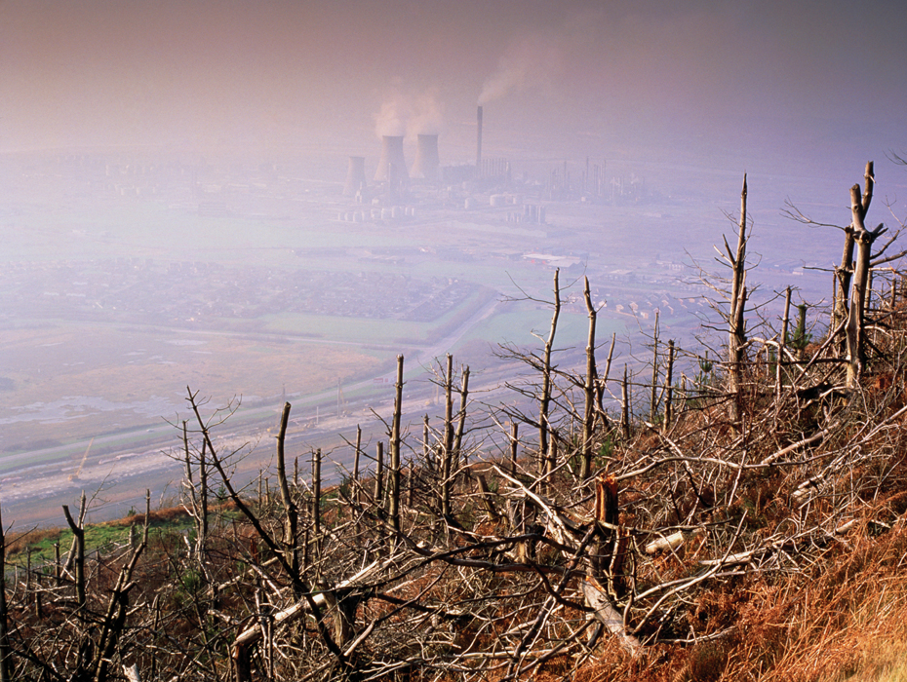
KEY CONCEPT Fossil fuel emissions affect the biosphere.

Slide 2
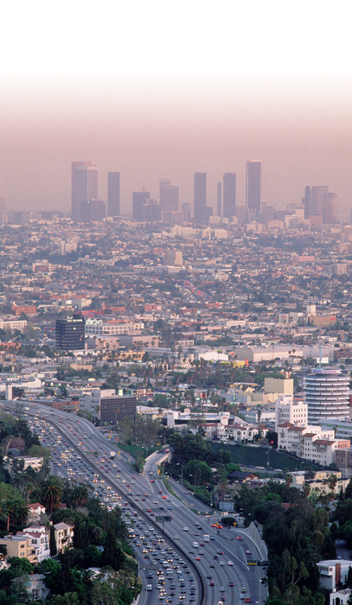
Pollutants accumulate in the air.
Pollution is any undesirable factor added to the air, water, or soil.
Smog is one type of air pollution.
sunlight interacts with pollutants in the air
pollutants produced by fossil fuel emissions
made of particulates and ground-level ozone

Slide 3
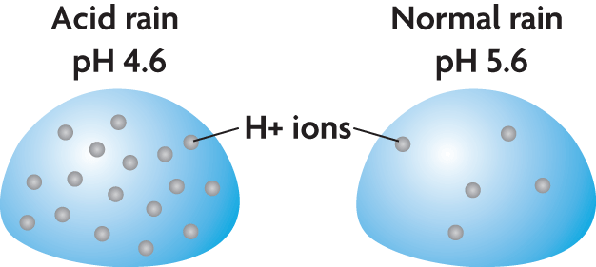
Smog can be harmful to human health.
Acid rain is caused by fossil fuel emissions.
produced when pollutants in the water cycle cause rain pH to drop
can lower the pH of a lake or stream
can harm trees

Slide 4
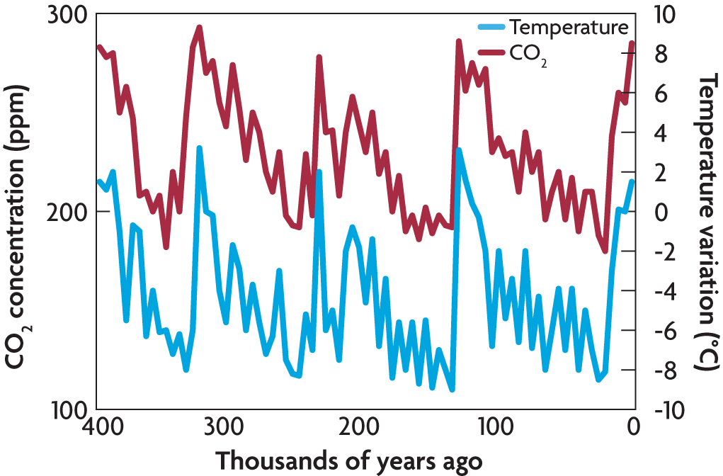
Air pollution is changing Earth’s biosphere.
The levels of atmospheric carbon dioxide rise and fall over time.
High levels of carbon dioxide are typical of Earth’s warmer periods.

Slide 5
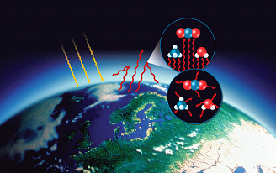
The greenhouse effect slows the release of energy from Earth’s atmosphere.
sunlight penetrates Earth’s atmosphere
energy is absorbed and reradiated as heat
greenhouse gases absorb longer wavelengths
Greenhouse gas molecules rerelease infrared radiation
carbon dioxide (CO₂)
methane (CH₄)
water (H₂O)

Slide 6
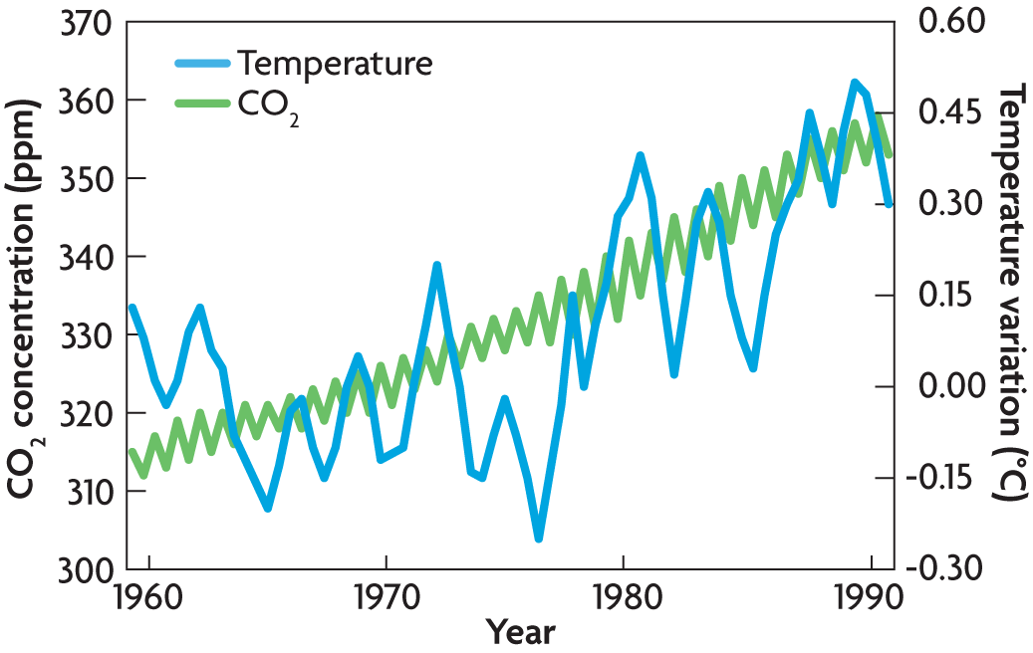
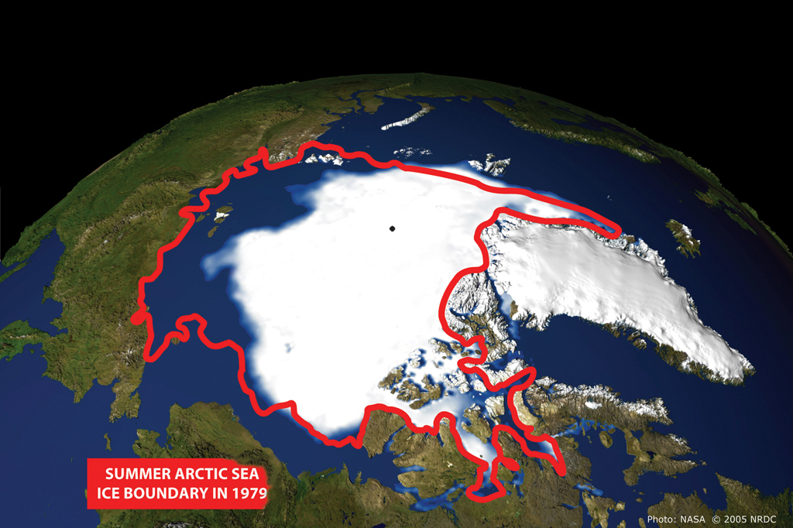
Global warming refers to the trend of increasing global temperatures.
North Pole

