Slide 1
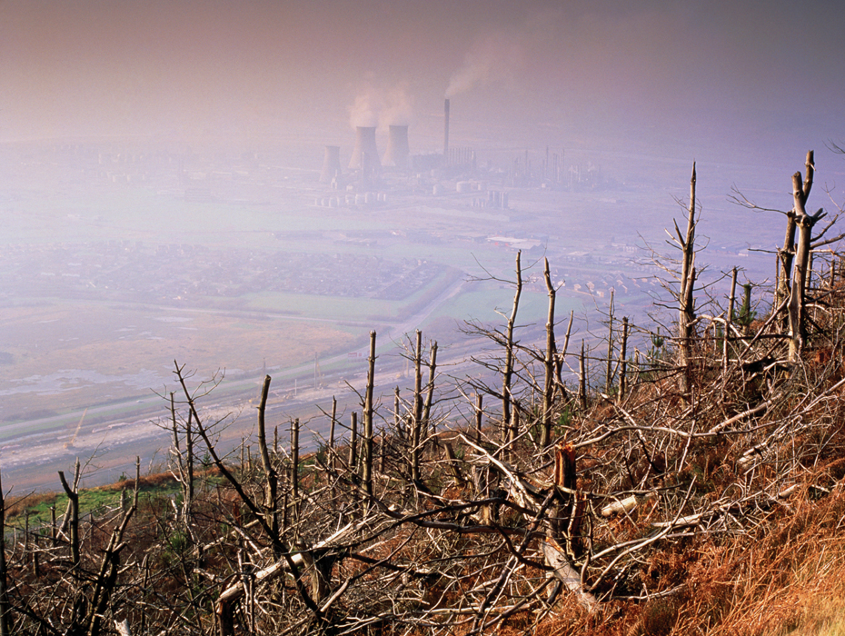
KEY CONCEPT Pollution of Earth’s freshwater supply threatens habitat and health.

Slide 2
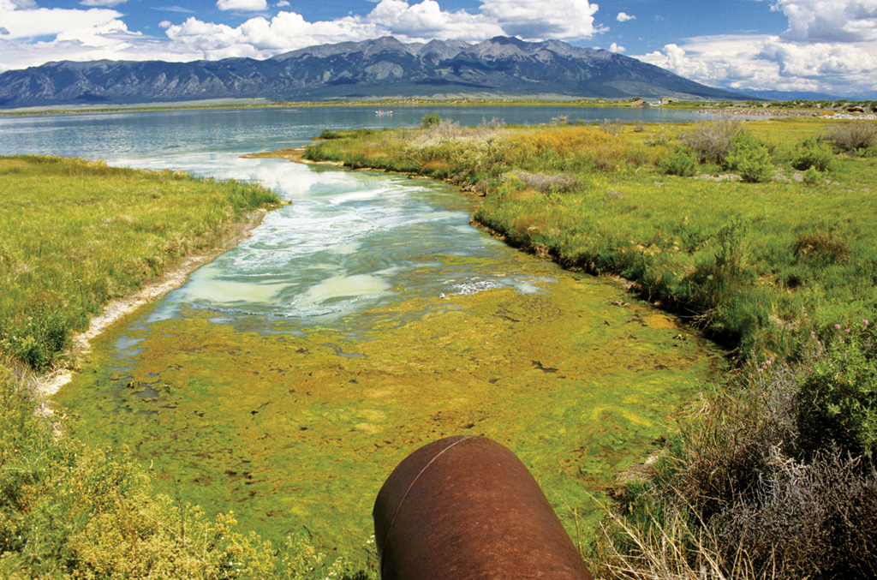
Water pollution affects ecosystems.
Pollution can put entire freshwater ecosystems at risk.

Slide 3
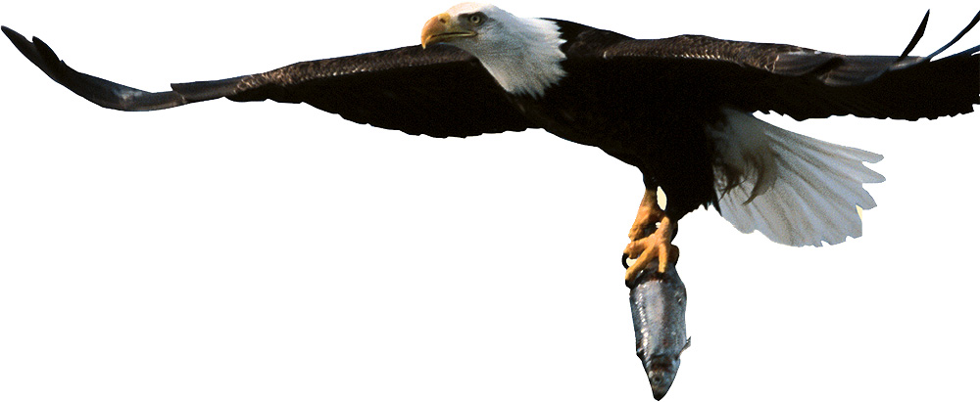
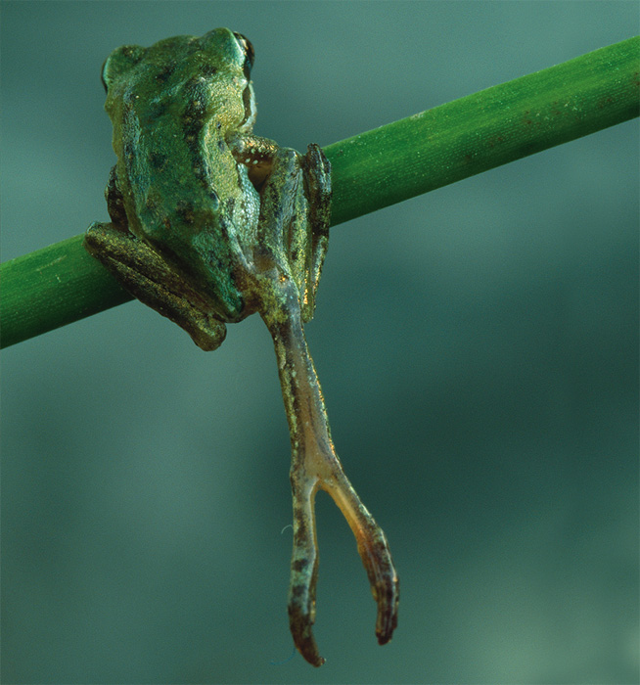
Indicator species provide a sign of an ecosystem’s health.
amphibians
top predators

Slide 4
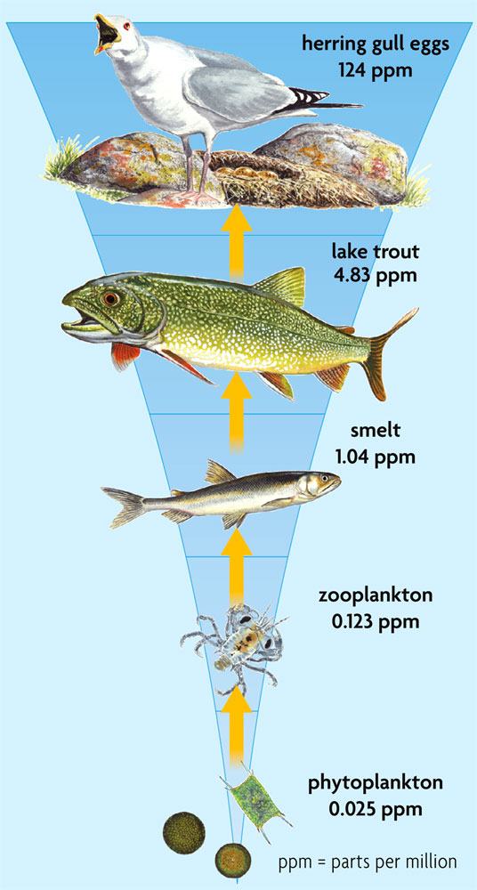
Biomagnification causes accumulation of toxins in the food chain.
Pollutants can move up the food chain.
predators eat contaminated prey
pollution accumulates at each stage of the food chain
Top consumers, including humans, are most affected.

