Slide 1
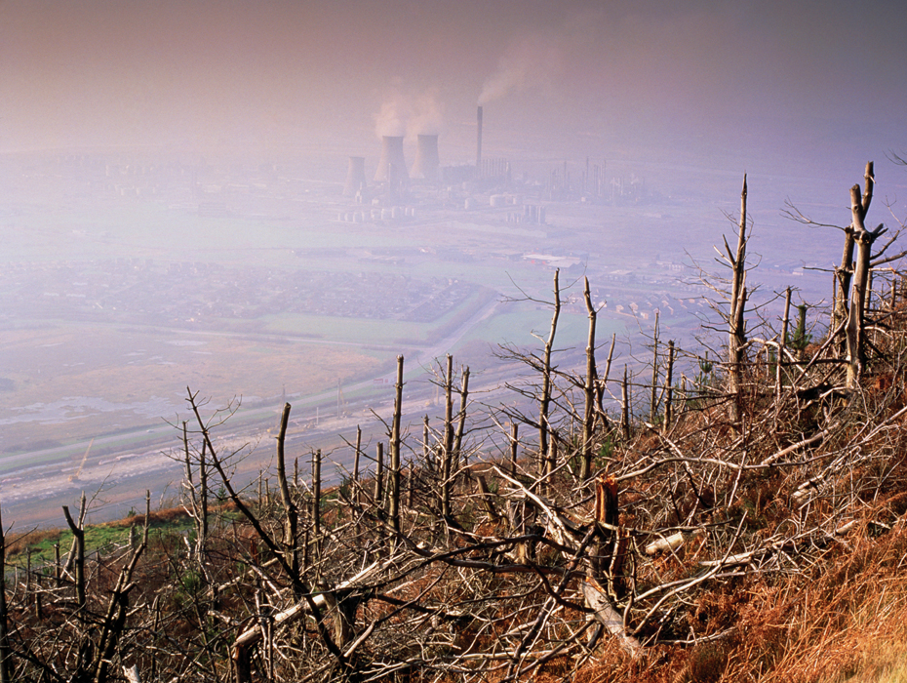
KEY CONCEPT Conservation methods can help protect and restore ecosystems.

Slide 2
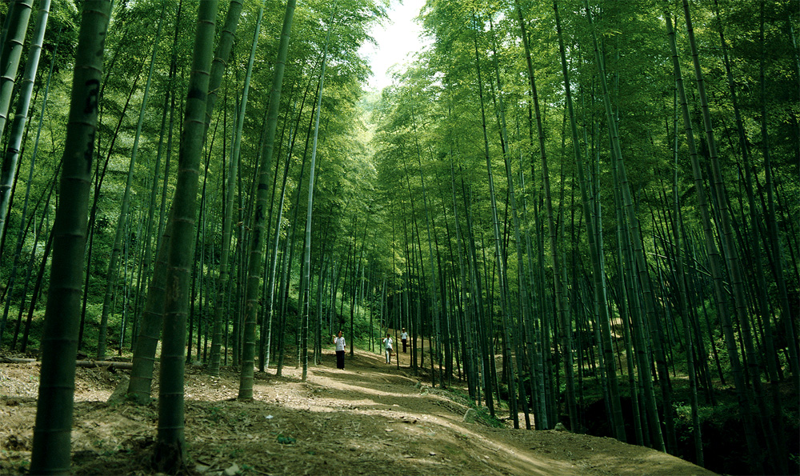
Sustainable development manages resources for present and future generations.
Sustainable development meets needs without hurting future generations.
resources meet current needs
resources will still be available for future use

Slide 3
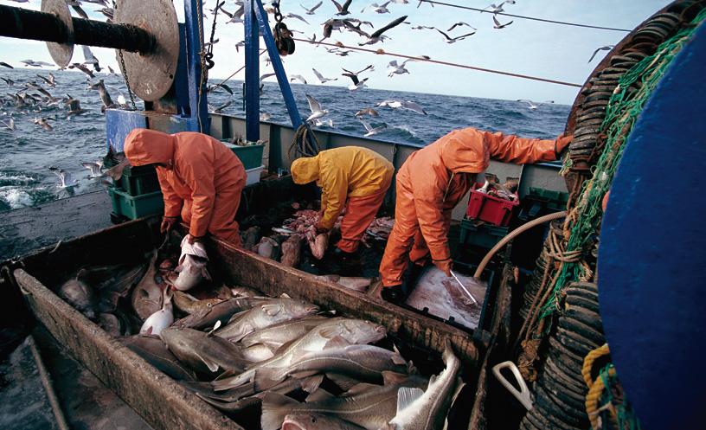
The timber industry has started to adopt sustainable practices.
Global fisheries have adopted several sustainable practices.
rotation of catches
fishing gear review
harvest reduction
fishing bans

Slide 4
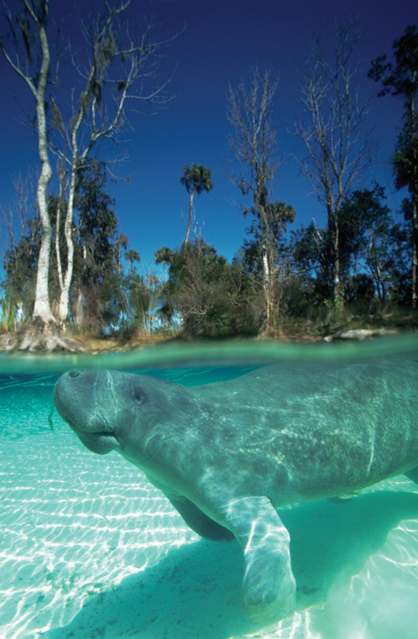
Conservation practices focus on a few species but benefit entire ecosystems.
The Endangered Species Act works to protect individual species from extinction.
A listed species is often called an umbrella species.
the habitat in which the species lives must be protected
other species are protected because they share the ecosystem

Slide 5
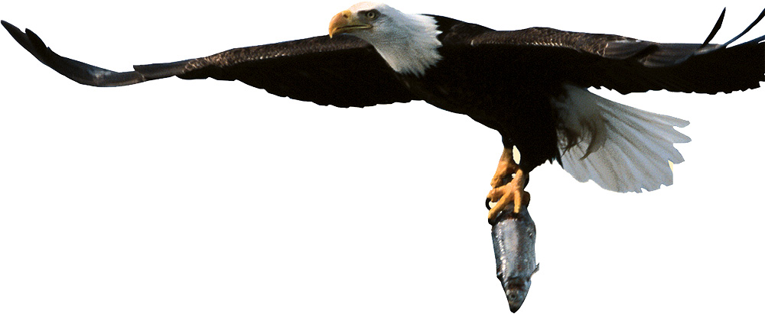
Protecting Earth’s resources helps protect our future.
The Environmental Protection Agency (EPA) was created in 1970.
The EPA develops policies and regulations to protect the environment.
Legislation helps to protect the environment and endangered species.
Clean Air Act
Clean Water Act
Endangered Species Act

Slide 6
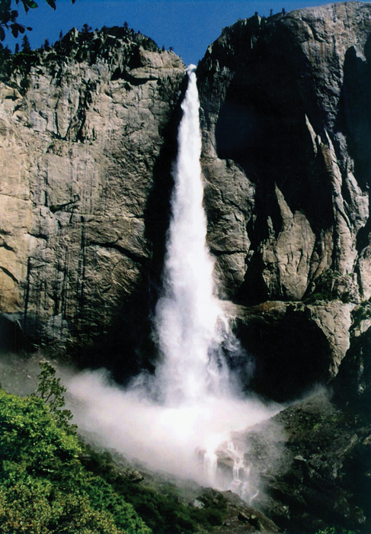
The National Park Service helps manage public lands.
The park system includes over 390 areas, covering 84 million acres.

Slide 7
There are several ways that people can help protect the environment.
control population growth
develop sustainable technology and practices
protect and maintain ecosystems

